Slide 1

Oncotype DX® Colon Cancer Assay
Personalizing Risk Assessment in
the Management of
Stage II Colon Cancer

Slide 2
Oncotype DX® Colon Cancer Assay
The Challenge with the Stage II Colon Cancer Patient
Oncotype DX Colon Cancer Assay
Development & Validation
Implications for Clinical Practice in
Stage II Colon Cancer

Slide 3
A Case Study
72 year-old male with 1.5-cm tumor
How should this patient be evaluated for treatment?
What is his risk of disease recurrence?
How likely is he to benefit from chemotherapy?
Tumor type | Adenocarcinoma of the sigmoid colon
Tumor size | 1.5 cm
T stage | T3
Histologic grade | Low grade
Lymph node status | Negative
# lymph nodes assessed | 16
MMR status | N/A
LVI | No
Perforation | No
Obstruction | No
Case submitted by: Ignacio Echenique, MD, Auxilio Mutuo, San Juan, Puerto Rico.
Notes:
This is a typical stage II colon cancer patient: a 72 year old with a T3 N0 tumor without any of the existing pathologic risk factors and who otherwise seems to be a good candidate for chemotherapy.
The questions are:
How should this patient be evaluated for treatment?
What is his risk for a disease recurrence?
How likely is he to benefit from chemotherapy?

Slide 4
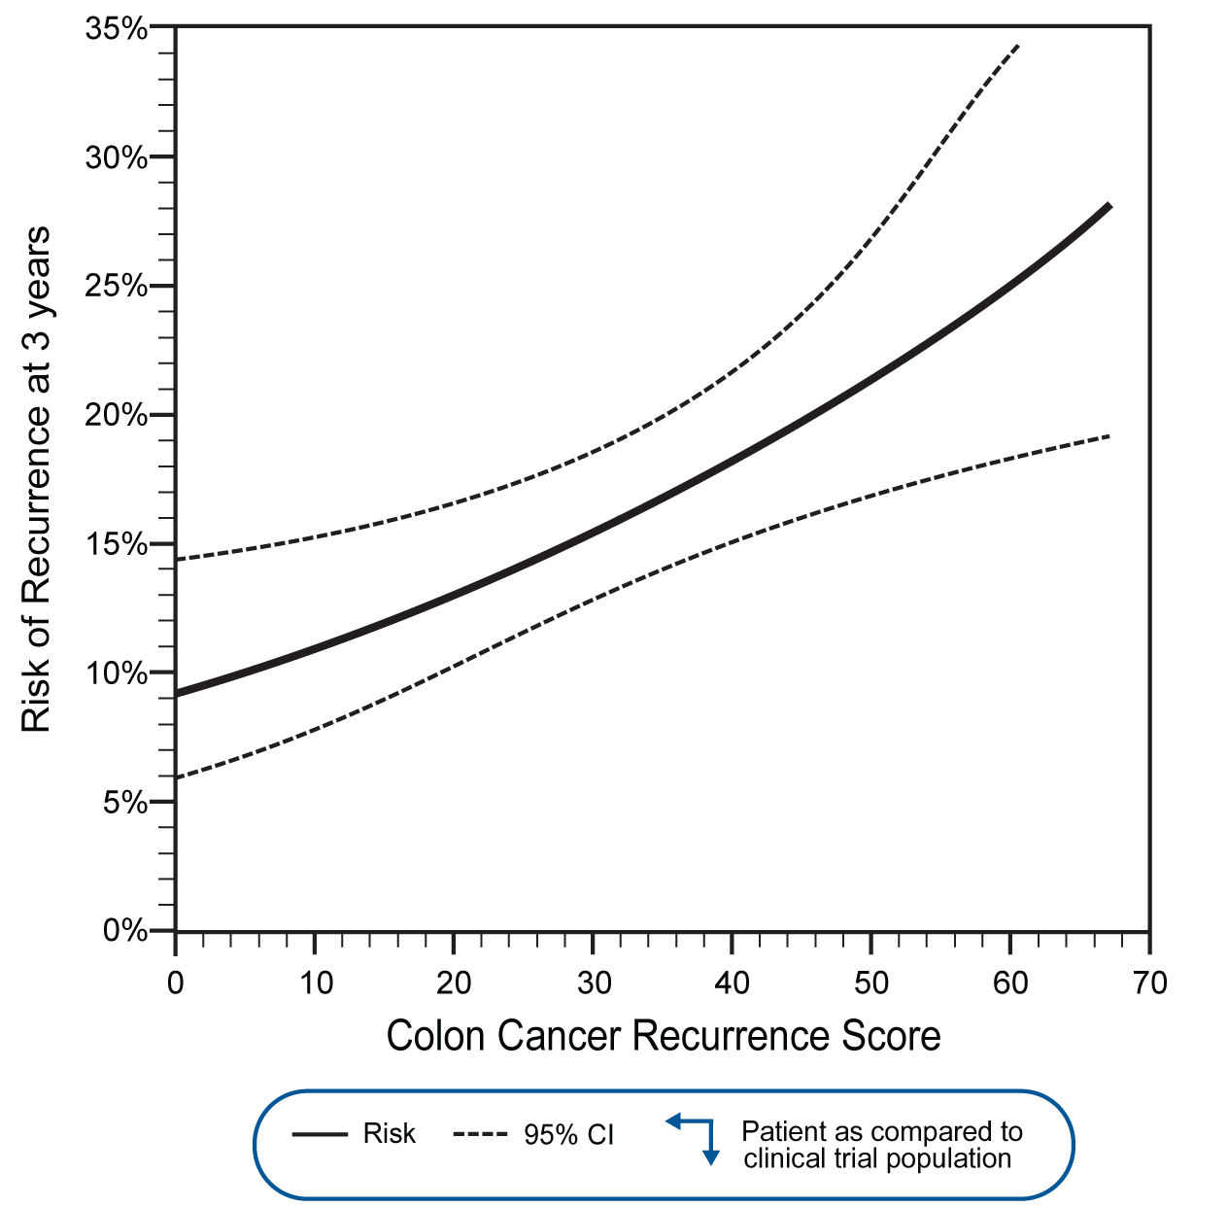
A Case Study
RESULTS
Recurrence Score = 51
CLINICAL EXPERIENCE: STAGE II COLON CANCER
In the clinical validation study*, patients with stage II colon cancer randomized to surgery alone who had a Recurrence Score of 51 had a risk of recurrence at 3 years of 22% (95% CI: 17%-28%).
Risk of Recurrence at 3 Years vs Recurrence Score
*The clinical experience with Oncotype DX on this page is from a clinical validation study with prospectively defined endpoints involving 1,436 patients with stage II colon cancer from the QUASAR clinical trial; 711 randomized to surgery alone and 725 to surgery followed by 5FU/LV chemotherapy. There were no patients who had a Recurrence Score > 67.
Kerr D, et al. J Clin Oncol. 2009;27: abstract 4000.
Notes:
This patient’s RS is 51, with an estimated risk of recurrence of 22% at 3 years. This patient’s recurrence risk is as high as that for a T4 stage II colon cancer patient (stage IIB).

Slide 5
The challenge: Which stage II colon cancer patients should receive adjuvant chemotherapy?
It is unclear which 75-80% of patients are cured with surgery alone
Absolute chemotherapy benefit is small
Chemo has significant toxicity and impacts quality of life
  Median age 71 years old; comorbidities and competing causes of mortality
Selection of patients for chemotherapy is subjectively based on:
  Risk assessment with a limited set of clinical/pathologic markers
  Patient age, comorbidities, patient preference
Notes:
When considering the clinical questions in colon cancer where genomics could make a major impact, our conversations with oncologists led us to focus on the challenge of stage II colon cancer. Some considerations in that challenge are as follows:
First is the fact that 75% to 80% of these patients are cured with surgery alone. Identifying who exactly those 75-80% are has been a significant challenge.
We know that in an unselected patient population of stage II colon cancer, there is a significant but small absolute benefit of adjuvant chemotherapy. Moreover, for this patient population which is largely elderly, six months of therapy and potential toxicities may have an impact on quality of life. There are also competing causes of death and comorbidities for these patients.
ASCO and NCCN guidelines suggest that the benefit of adjuvant therapy in stage II colon cancer is <5%. Results from the QUASAR study (Lancet 2007 370:2020-9) are consistent with a 3.6% absolute survival benefit of adjuvant 5FU/LV in stage II disease. This level of benefit is consistent with meta-analyses of adjuvant therapy trials in stage II colon cancer patients (Gill et al JCO 2004; Sargent et al JCO 2009).
Toxicity of adjuvant therapy is significant in colon cancer because of (1) the 6-month duration of colon cancer therapy, (2) treatment in a population with average age of 70 years, (3) 0.5% toxic death rate with 5FU in multiple trials, (4) diarrhea, mucositis, myelosuppression, and other acute toxicities associated with 5FU, and (5) long-term peripheral neurotoxicity associated with oxaliplatin, which is in common use even for stage II colon cancer
The paradigm in the community today is that selection of patients for chemotherapy is subjectively based on two elements. On the one hand, there is risk assessment with a limited set of clinical and pathologic markers (qualitative risk assessment); on the other, another important driver of decision-making is a collection of subjective criteria, including patient age, comorbidities, and patient preference.
The guidelines emphasize the importance of risk assessment in treatment planning for stage II colon cancer. Current markers of risk (clinical and pathologic markers such as bowel perforation, bowel obstruction, T stage, number of nodes examined, lympho-vascular invasion, tumor grade) are not informative for the majority of patients, and thus, there is a pressing need for more accurate, individualized information on recurrence risk in stage II colon cancer to better identify the individual patients who require more aggressive therapy.
In current US practice, it is estimated from market research that 25-35% of stage II colon cancer patients receive adjuvant therapy, with more than 50% of those chemotherapy-treated patients receiving oxaliplatin-based chemotherapy.
References:
Vicuna B and Benson AB: Adjuvant therapy for stage II colon cancer: Prognostic and predictive markers. JNCCN 2007; 5:927-936.
Benson AB, Schrag D, Somerfield MR, et al: American Society of Clinical Oncology recommendations on adjuvant chemotherapy for stage II colon cancer. J Clin Oncol 2004; 22: 3408-3419.
NCCN Clinical Practice Guidelines in Oncology: Colon Cancer. V.2.2011.
Mamounas E, Wieand S, Wolmark N, et al: Comparative efficacy of adjuvant chemotherapy in patients with Dukes' B versus Dukes' C colon cancer: Results from four National Surgical Adjuvant Breast and Bowel Project adjuvant studies (C-01, C-02, C-03, C-04). J Clin Oncol 1999; 17:1349-1355.
Gill S, Loprinzi CL, Sargent DJ, et al: Pooled analysis of fluorouracil-based adjuvant therapy for stage II and III colon cancer: Who benefits and by how much? J Clin Oncol 2004; 22:1797-1806.
Sargent D, Sobrero A, Grothey A, et al. Evidence for cure by adjuvant therapy in colon cancer: Observations based on individual patient data from 20,898 patients on 18 randomized trials. J Clin Oncol 2009 27:872-877.
QUASAR Collaborative Group: Adjuvant chemotherapy versus observation in patients with colorectal cancer: a randomized study. Lancet 2007; 370:2020-2029.

Slide 6
Current Management of
Stage II Colon Cancer
NCCN Guidelines™ list wide range of “acceptable” management strategies for resected stage II colon cancer:¹
  Observation
  5FU/LV or capecitabine
  5FU/LV/oxaliplatin (for high-risk features)
  Clinical trial
Estimated % receiving adjuvant therapy: 25-35%
  Use of adjuvant regimens in practice today:²
    5FU/LV 3%
    FOLFOX + Avastin 5%
    FOLFOX 89%
NCCN® Clinical Practice Guidelines for Oncology: Colon Cancer v2.2011. National Comprehensive Cancer Network (NCCN) and NCCN are registered trademarks of NCCN. NCCN do not endorse any product or therapy
OncoReport: Medical Oncology T3 2010, Interactive Clinical Intelligence, www.icimrr.com
Notes:
This subjectivity in decision-making for stage II colon cancer is reflected in the guidelines. The NCCN guidelines list a range of acceptable management strategies for stage II colon cancer ranging all the way from observation to single-agent chemotherapy to combination chemotherapy with oxaliplatin to clinical trial.
Not surprisingly, market research suggests a tremendous variability in management of stage II colon cancer from oncologist to oncologist, from center to center, from region to region, etc. Some oncologists are treating the majority of their stage II patients while others are not treating any.
Based on our market research, for all stage II colon cancer in the United States, approximately a third of patients receive adjuvant chemotherapy. What we understand also is that, for stage II patients receiving chemotherapy, the distribution of chemotherapy regimens in use have been trending to increased use of combinations with oxaliplatin (especially FOLFOX).

Slide 7
Existing Tools for Selecting Stage II Patients for Treatment Are Inadequate
Recurrence Risk
Bowel obstruction or perforation
T-Stage
# of nodes assessed
Tumor grade
Lymphatic/vascular invasion
Margin status
MMR
Treatment Benefit
MMR?
According to current guidelines:^{1,2}
No molecular markers have been routinely established in clinical practice for stage II colon cancer.
Treatment decisions are based on the expectation that higher risk stage II patients derive larger absolute benefit with adjuvant chemotherapy.
NCCN® Clinical Practice Guidelines for Oncology: Colon Cancer v2.2011.
Benson AB 3rd, et al. J Clin Oncol. 2004;22:3408-3419.
Notes:
How are stage II colon cancer patients being assessed for their recurrence risk today?
There are a limited set of clinical and pathologic markers that are in current practice and recommended by guidelines: obstruction or perforation, T stage, the number of nodes examined, tumor grade, lymphatic vascular invasion, and margin status.
According to the current guidelines, it’s quite striking that unlike in breast cancer where we’ve had decades of use of molecular markers (e.g. ER, PR, HER2) to guide treatment decisions, there are limited molecular markers that are established for stage II colon cancer. There are no markers in stage II colon cancer that identify patients specifically with very high or very low proportional risk reduction with chemotherapy. These are limitations to the system that we have today.
Use of MMR testing for prognostic and predictive assessment remains an evolving area in guidelines and clinical practice. While MMR deficiency has been consistently shown in the literature to be a statistically significant predictor of good outcome in stage II colon cancer, the data remains controversial as to the predictive benefit. MMR has been added to the NCCN guidelines for consideration in stage II patients where fluoropyrimidine therapy is being considered.
₇

Slide 8
Current Recurrence Risk Markers in Stage II
Key Considerations
Level of evidence supporting each marker:
  Which markers can be considered to be prospectively validated?
Standardization of markers:
  What is the evidence for reproducibility in practice?
Application of markers:
  What is the magnitude of higher risk predicted by each marker (if at all)?
  How clinically actionable is each marker for adjuvant therapy decisions?
  Does each marker provide independent recurrence risk information beyond that provided by other markers?
Notes:
Existing markers used today have not been standardized and have never been prospectively validated. Although many of these factors are included in current guidelines, the basis for their recommendations have been based on historical studies dating back 20-30 years in mixed CRC populations across different stages of disease. These studies would be considered to represent lower levels of evidence according to today’s standards.
Furthermore, though the guidelines list multiple markers to assess risk, each marker’s relative importance is not equivalent. As such, it is difficult for physicians to interpret the collective findings from these various markers.

Slide 9
Stage II Colon Cancer:
T4 Stage Predicts Poor Outcome
p < .001
93
85
83
72
64
44
8
Stage II colon cancer: 5-yr risk of death = 17.5% overall
17% had T4 tumors (stage IIB) with 27.8% risk of death
83% had T3 tumors (stage IIA) with 15.3% risk of death (near average risk for all stage II)
T4 = high risk; T3 = average risk (not necessarily low risk)
O’Connell JB, et al. J Natl Cancer Inst. 2004;96:1420-1425.
Notes:
In this analysis of >100,000 patients from the SEER database, stage II colon cancer patients had 17.5% 5 year risk of death.
For 17% of stage II colon cancer patients with T4 stage, 5 year risk of death was significantly higher, at 27.8%. Note that this 5-year risk of death for stage IIB (T4) patients is even worse than that for stage IIIA patients (28% vs 17%, p< .001).
Notably, for the 83% of patients with T3 stage, 5 year risk of death was very near the risk for the overall stage II population (5 yr risk of death in T3 = 15.3% vs 17.5% for all stage II). This finding demonstrates that while T4 stage is informative for the 17% of stage II colon cancer patients with this marker, T3 stage does not provide meaningful discrimination in risk from the average and is thus not informative for the patients with T3 stage (83% of all stage II colon cancer patients).

Slide 10
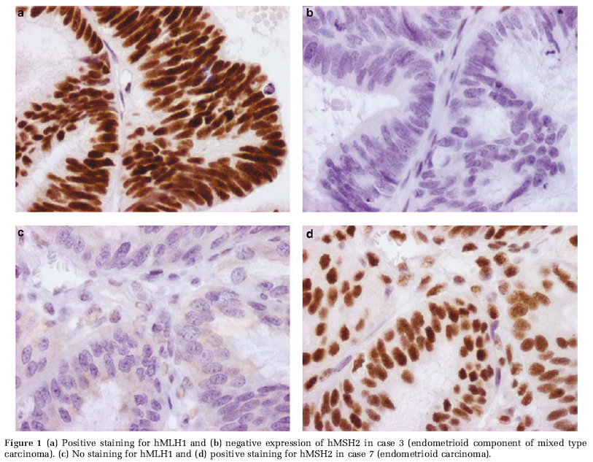
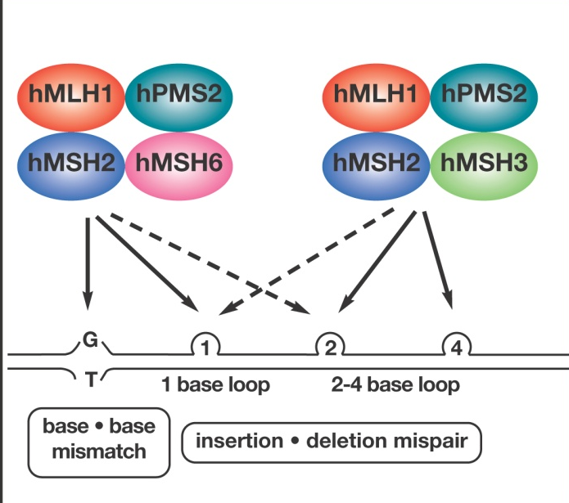
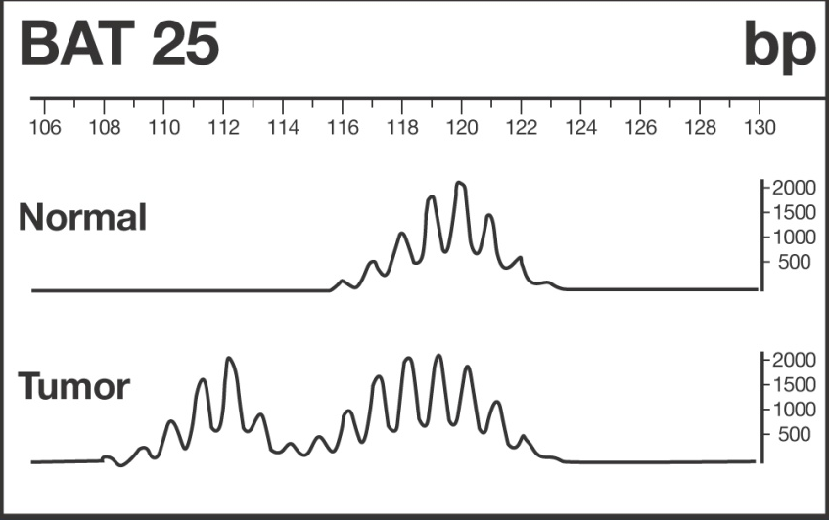
Mismatch Repair Deficiency (MMR-D):
Unique Biological Subgroup of Colon Cancer
IHC for MMR protein status
MLH1+
MSH2-
MLH1-
MSH2+
Thus, IHC for MMR proteins and PCR for MSI detect two manifestations of the same tumor biology:
MMR-D is synonymous with MSI-H
MMR-P is synonymous with MSI-L/MSS
PCR on tumor DNA for MSI (microsatellite instability)
Imai K, et al. Carcinogenesis. 2008;29:673-680.
Umetani N, et al. Ann Surg Oncol. 2000;7:276-280.
Rosen DG, et al. Mod Pathol. 2006;19:1414-1420.
Notes:
A defective DNA mismatch repair (MMR) mechanism is a key biologic characteristic of ~15% of stage II colon cancer patients. This biological characteristic, also called MMR deficiency, represents one of two distinct mechanisms for producing colon tumors, with the other mechanism being chromosomal instability – both mechanisms lead to accumulation of genetic changes in tumors which ultimately drive tumor formation.
In normal cells, the presence of a multi-protein “machine” (panel at left) allows for repair of routinely encountered errors in DNA replication. This machine ceases to function if any of its components (e.g. MLH1, MSH2 or the other proteins depicted) is missing. Loss of expression of MMR proteins in tumor, especially MLH1 and MSH2 (accounting for >95% of patients with this characteristic), results in an inability to faithfully replicate DNA, which in turn leads to accumulation of mutations which drive tumorigenesis. One readily detectable manifestation of tumor MMR deficiency is an inability to faithfully replicate microsatellite DNA sequences (short stretches of repetitive sequence DNA found throughout the genome), such that the length of these microsatellites in tumor DNA is not faithfully preserved. Differences in the lengths of microsatellite DNA sequences observed in MMR deficient tumors relative to normal tissue has thus been termed microsatellite instability (MSI).
Colon tumors with MMR deficiency can be identified either by (1) IHC for the MMR proteins (top right panel) – MMR proficient = both MLH1 and MSH2 staining positive and MMR deficient = either MLH1 or MSH2 staining negative, or (2) PCR assessment of DNA markers for MSI, where high-grade MSI (MSI-H) demonstrates lack of faithful replication of DNA in tumor relative to normal tissue. In tumors exhibiting the MSI-H phenotype (bottom right panel), tumor DNA is of different lengths compared to normal tissue.
MMR deficiency (MMR-D) directly results in the MSI-H phenotype. Thus, MMR-D is considered synonymous with MSI-H. It is worth noting that concordance studies of MMR status assessment by IHC for MMR proteins vs PCR for MSI have shown that the two methods have >90% concordance overall. A very recent study by CALGB, involving ~700 colon cancer patients from CALGB 89803, rigorously demonstrated that IHC for MLH1 and MSH2 had >97% concordance with PCR for MSI (using a 10 marker panel) (Bertagnolli et al JCO 2009).
References:
Bertagnolli MM, Niedzwiecki D, Compton CC, et al: Microsatellite Instability Predicts Improved Response to Adjuvant Therapy with Irinotecan, Fluorouracil, and Leucovorin in Stage III Colon Cancer: Cancer and Leukemia Group B Protocol 89803. J Clin Oncol. 2009; 27:1814-1821.
Imai and Yamamoto. Carcinogenesis 2008
Umetani, Annals of Surgical Oncology 2000
Rosen et al. Modern Pathology (2006) 19, 1414-1420

Slide 11
MMR-D Identifies Resected Colon Cancer Patients With Low Recurrence Risk
Pooled Analysis of Stage II and III colon cancer patients (surgery alone)
100
MMR-D
80
60
Overall Survival (%)
MMR-P
40
20
No adjuvant chemotherapy, n = 287
P = 0.004
0
0
1
2
3
4
5
6
7
8
Years after Randomization
Multiple studies have consistently demonstrated that the ~15% of colon cancer patients with MMR-D tumors have markedly lower recurrence risk, particularly for the stage II colon cancer patient.
Adapted from Ribic CM, et al. N Engl J Med. 2003;349:247-257.
Notes:
Multiple studies have shown that stage for stage, patients with MMR-D tumors have a more favorable prognosis compared to patients with MMR-P tumors. This seminal 2003 publication showed that of the 287 stage II/III patients (all untreated), patients with MMR-D tumors had a better five-year rate of overall survival compared to patients with MMR-P tumors (hazard ratio for death, 0.31 [95 percent confidence interval, 0.14 to 0.72]; P=0.004).
Ribic CM, Sargent DJ, Moore MJ, et al. Tumor microsatellite-instability status as a predictor of benefit from fluorouracil-based adjuvant chemotherapy for colon cancer. N Engl J Med. 2003;349(3):247-57.

Slide 12
MMR-D Has Consistently Been Shown to Be a Favorable Prognostic Marker
Source | Stage / Treatment | Endpoint | MMR-D vs MMR-P HR (95% CI); p-value
Ribic et al¹ | II/III Surgery alone | Overall survival | 0.31 (0.14-0.72) p=0.004
Sargent et al² | II/III Surgery alone | Disease-free survival Overall survival | 0.46 (0.22-0.95); p=0.03 0.51 (0.24-1.10); p=0.06
Gray et al³ (QUASAR) | II Surgery alone | Recurrence-free interval | 0.31 (0.15-0.63) p<0.001
Roth et al⁴ (PETACC-3) | II 5FU ± irinotecan | Relapse-free survival | 0.30 p=0.004
The ~15% of stage II colon cancer patients with MMR-deficient tumors have been found consistently to have a lower risk
of recurrence and/or death
Ribic CM, et al. N Engl J Med. 2003;349:247-257.
Sargent DJ, et al. J Clin Oncol. 2010;28:3219-3226.
Gray R, et al. J Clin Oncol. In press.
Roth AD, et al. J Clin Oncol. 2009;27: abstract 288.
Notes:
There has been remarkable consistency in the literature demonstrating that MMR-D is associated with more favorable prognosis in stage II colon cancer. This includes findings from the QUASAR clinical validation study for Oncotype DX. In addition, a recent PETACC-3 analysis of MMR/MSI in a large dataset of stage II and stage III colon cancer has also reported a markedly improved outcome for stage II colon cancer patients with MMR-D tumors.
Ribic CM, Sargent DJ, Moore MJ, et al. Tumor microsatellite-instability status as a predictor of benefit from fluorouracil-based adjuvant chemotherapy for colon cancer. N Engl J Med. 2003;349(3):247-57.
Sargent DJ, Marsoni S, Monges G, et al. Defective Mismatch Repair As a Predictive Marker for Lack of Efficacy of Fluorouracil-Based Adjuvant Therapy in Colon Cancer. J Clin Oncol. 2010;28(20): 3219-3226.
Kerr D, Gray R, Quirke P et al. A quantitative multigene RT-PCR assay for prediction of recurrence in stage II colon cancer: Selection of the genes in four large studies and results of the independent, prospectively designed QUASAR validation study. J Clin Oncol 27:15s, 2009 (suppl; abstr 4000).
Roth AD, Tejpar S, Yan P, et al. Correlation of molecular markers in colon cancer with stage-specific prognosis: Results of the translational study on the PETACC 3 - EORTC 40993-SAKK 60-00 trial. J Clin Oncol 27:15s, 2009 (suppl; abstr 288).

Slide 13
High Tumor Grade Consistently Found NOT to be a Marker of High Recurrence Risk in Stage II Colon Cancer
Source | Stage / Treatment | N | HR (High vs. Low Grade) p-value | High Tumor Grade Conclusions
NSABP, CCF¹ | II Surgery alone | 634 | 0.58 for RFI p=0.033 | Associated with lower recurrence risk in stage II and higher recurrence risk in stage III (significant interaction of grade and stage p=0.005)
QUASAR² | II Surgery alone | 711 | 0.62 for RFI p=0.026 | Associated with lower recurrence risk in stage II
PETACC-3³ | II 5FU ± irinotecan | 420 | 0.60 for RFS p=0.55 | Not a statistically significant predictor of outcome in stage II
CALGB 9581⁴ | II Surgery alone | 690 | 0.74 for RFI p=0.11 | Not a statistically significant predictor of outcome in stage II
MSKCC⁵ | II Surgery alone | 448 | HR not reported p=ns | Not a statistically significant predictor of outcome in stage II
O’Connell MJ, et al. J Clin Oncol. 2010;28:3937-3944.
Gray R, et al. J Clin Oncol. In press.
Roth AD et al. J Clin Oncol. 2010;28:466-474.
Venook AP, et al. J Clin Oncol. 2011;29: abstract 3518.
Quah HM, et al. Dis Colon Rectum. 2008;51:503-507.
Notes:
Data supporting high tumor grade came from small historical series of mixed stage. Now, multiple large studies with focus on stage II colon cancer (nearly 3000 stage II colon cancer patients across 5 large studies) have found that high tumor grade is not a predictor of higher recurrence risk. High tumor grade has been consistently found to be either not significantly associated with recurrence (Memorial Sloan Kettering study, PETACC-3, CALGB 9581), or, when significant, high tumor grade has been found to actually be a predictor of lower recurrence risk (NSABP/CCF, QUASAR). The key conclusion here is that high tumor grade should not be used to identify patients at higher risk of recurrence in stage II.
Kerr D, Gray R, Quirke P et al. A quantitative multigene RT-PCR assay for prediction of recurrence in stage II colon cancer: Selection of the genes in four large studies and results of the independent, prospectively designed QUASAR validation study. J Clin Oncol 27:15s, 2009 (suppl; abstr 4000).
Roth AD, Tejpar S, Yan P, et al. Correlation of molecular markers in colon cancer with stage-specific prognosis: Results of the translational study on the PETACC 3 - EORTC 40993-SAKK 60-00 trial. J Clin Oncol 27:15s, 2009 (suppl; abstr 288).

Slide 14
Lymphovascular Invasion: Inter-Observer Variability Among Pathologists Is Substantial
Design: Lymphovascular Invasion (LVI) evaluated by 6 GI pathologists (Vanderbilt, MGH, MUSC, Cedars Sinai, Dartmouth)
  50 stage II, moderately differentiated CRC
  Assessment of H&E and IHC for D2-40 and CD31 (endothelial markers)
Results
  Low concordance (kappa 0.18-0.28) with H&E
  Minimal improvement with IHC (kappa 0.26-0.42)
Conclusions
  “Interobserver variability in diagnosis of LVI was substantial on H&E slides and did not improve upon use of IHC. Agreement in evaluation of large vessel invasion was only slightly higher than would be seen by chance alone.”
  “This study highlights the need for criteria in evaluation of LVI, as this assessment may impact patient prognosis and thus change the course of clinical treatment.”
Harris EI, et al. Am J Surg Pathol. 2008;32:1816-1822.
Notes:
Key Point: This study highlights the need for standardized criteria in evaluation of LVI. Variability in assessing LVI may impact the accuracy of assessing patient prognosis and the course of clinical treatment.
LVI in colorectal cancer is included in NCCN guidelines for assessing recurrence risk in Stage II patients. However, the degree of inter-observer agreement among pathologists for LVI has been unclear. Harris et al, conducted an inter-observer variability study to assess the agreement among 6 GI pathologists across 5 academic institutions in their diagnosis of LVI using tissues from 50 AJCC stage II moderately differentiated CRC tumors from 1990-2005.
H&E slides from 50 cases were circulated to 6 GI pathologists, who independently assessed small and large vessel invasion. No diagnostic guidelines were given to the participating pathologists; each was instructed to apply the criteria for LVI that he or she used in daily practice. IHC for D2-40 and CD31 was performed on corresponding paraffin blocks. The IHC slides were randomized, recirculated, and rescored for LVI. Results were analyzed using kappa and percent agreement.
Kappa is a measure of agreement between raters which accounts for the amount of agreement due to chance alone. If the number of categories is small (for example, just two - LVI present or absent), the agreement expected by chance alone could be substantial and a simple proportion of how often pathologists gave the same ratings would be misleading. It is important to use measures such as kappa to properly characterize the agreement Kappa <0.4 is considered to indicate low/fair agreement, 0.4 to 0.6 moderate and above 0.6 good agreement.
Agreement was fair for H&E small vessel invasion (κ = 0.28). The least agreement was seen in interpretation of H&E large vessel invasion (κ = 0.18). Agreement was not improved by using IHC stains: CD31 (large vessel, κ = 0.42, small vessel, κ = 0.26) and D2-40 (κ = 0.32).
In conclusion, inter-observer variability in diagnosis of LVI was substantial on H&E slides and did not improve upon use of IHC. Agreement in evaluation of large vessel invasion was only slightly higher than would be seen by chance alone.

Slide 15
Recurrence Risk Assessment in Stage II Colon Cancer:
The Clinical Need
The majority (>70%) of stage II colon cancer patients are standard-risk (T3, MMR-proficient)
For the standard-risk patient, conventional markers such as grade and LVI, are not standardized or validated, and they do not provide reliable, accurate determinations of recurrence risk
Notes:
The unmet clinical need in stage II colon cancer is significant: The majority of patients, those with T3, MMR-Proficient tumors, are a heterogeneous group of patients who in aggregate have “standard risk” disease.
Current guidelines suggest using conventional markers such as grade and LVI, pathologic markers that have not been standardized nor validated for the purpose of predicting recurrence risk in stage II colon cancer. As such, these markers cannot be relied upon for providing accurate assessments of recurrence risk.

Slide 16
Oncotype DX® Colon Cancer Assay
The Challenge with the Stage II Colon Cancer Patient
Oncotype DX Colon Cancer Assay
Development & Validation
Implications for Clinical Practice in
Stage II Colon Cancer

Slide 17
An Evidence-Based Approach to
Personalized Medicine
Importance of understanding and treating the underlying individual tumor biology
Genomic assays for clinical decision-making must be “fit for purpose”
  Clinically validated in prospectively-designed studies of sufficient size and statistical power
  Supported by evidence in target patient population
  Demonstrated value beyond existing measures
  Standardized and reproducible
  Practical and clinically impactful
Adapted from Simon, et al. JNCI 2009; 101: 1446
Notes:
There is an increasing recognition of the importance of understanding and treating the underlying individual tumor biology for optimal care of the colon cancer patient. The question now is no longer whether genomics can enable personalized medicine in colon cancer but rather how best to develop, validate, and evaluate genomic assays for treatment decision-making in the clinic. A unifying principle in considering genomic assays (or any marker used for treatment decision-making e.g. clinical factors, pathology or imaging markers) is that they must satisfy multiple criteria to be considered “fit for purpose”, specifically fit for the purpose of impacting treatment decisions in clinical practice for individual colon cancer patients.
This slide summarizes the key criteria which should be used in evaluating whether a genomic assay should be applied to clinical decision-making in the clinic. These principles, as will be evident in the subsequent slides, are foundational for the development and validation strategy used for Oncotype DX.

Slide 18
Development and Validation of the Oncotype DX® Colon Cancer Assay
Colon Cancer Technical Feasibility
Development Studies
Surgery Alone
NSABP C-01/C-02 (n = 270)
Cleveland Clinic (n = 765)
Development Studies
Surgery + 5FU/LV
NSABP C-04 (n = 308)
NSABP C-06 (n = 508)
Selection of Final Gene List & Algorithm
Standardization and Validation of Analytical Methods
Clinical Validation Study – Stage II Colon Cancer
QUASAR (N = 1436)
Confirmation Study – Stage II Colon Cancer
CALGB 9581 (N = 690)
Notes:
Key points:
Rigorous development strategy built upon successful blueprint used to develop 21-gene Breast Cancer Recurrence Score
Size and number of development studies (NSABP and Cleveland Clinic) required to identify genes with confidence. Development studies included both stage II and stage III colon cancer patients.
Pre-specification of final genes, algorithm, and lab process PRIOR TO clinical validation in large, independent study of stage II colon cancer (QUASAR)
Limitation of NOT having had randomized studies to identify genes predictive of differential 5FU/LV benefit. However, including both surgery alone and surgery + 5FU treatment was important as it enabled an understanding of the impact of chemotherapy.
Details:
Data from stage II and stage III colon cancer patients were included in the development studies and used to identify and select the genes for both recurrence risk and differential 5FU/LV benefit. Selected genes and algorithms were evaluated in the subset of stage II patients from the development studies for verification.
For point #4: Treatment benefit genes would be expected to have a different relationship with patient outcome in surgery alone vs surgery+5FU (i.e. gene expression by treatment interaction). However, since the surgery alone and the surgery+5FU patients came from completely independent studies, a different relationship of a gene’s expression with outcome could either be related to treatment or something else different between the studies (e.g. patient populations). Given the lack of randomized studies (with tissue) comparing stage II colon cancer patients treated with surgery alone vs surgery + 5FU/LV, the strategy here was to use multiple well-defined single-arm studies for each of the treatment groups, reserving the single large randomized study (QUASAR) for validation.
References for Development Studies:
O’Connell MJ, Lavery I, Yothers G, et al. Relationship between tumor gene expression and recurrence in four independent studies of stage II/III colon cancer patients treated with surgery alone or surgery plus adjuvant 5-FU/LV. J Clin Oncol. in press.

Slide 19
The 12-Gene Oncotype DX®
Colon Cancer Recurrence Score®
Recurrence Score
Reference Genes
STROMAL
FAP
INHBA
BGN
CELL CYCLE
Ki-67
C-MYC
MYBL2
ATP5E
GPX1
PGK1
UBB
VDAC2
GADD45B
Recurrence Score =
– 0.15 × Stromal Group
– 0.30 × Cell Cycle Group
+ 0.15 × GADD45B
O’Connell MJ, et al. J Clin Oncol. 2010;28:3937-3944.
Kerr D, et al. J Clin Oncol. 2009;27: abstract 4000.
Notes:
This slide shows the 12-gene Recurrence Score, with 7 cancer genes and 5 reference genes. The 7 cancer genes include the 2 key biologic pathways (cell cycle genes and stromal genes) identified as being associated with recurrence in the development studies, as well as an individual gene GADD45B (associated with cellular response to stress).
Details:
The Recurrence Score contains gene groups consistently identified in the 1851 patients from the development studies, and the validation of the Recurrence Score in QUASAR provides strong support for their biological relevance.
Expression of the cell cycle group, including Ki67, is associated with better outcome in stage II colon cancer following surgery, and this result is consistent with reports in the literature, including studies by the NSABP. Cell cycle genes are well-known to produce different effects in different biological contexts, ranging from promotion of proliferation to induction of cell senescence or apoptosis. Expression of the stromal gene group is associated with poor outcome in colon cancer, which is consistent with observations in the literature that stromal genes are associated with induction of tumor cell proliferation, tumor invasion, and metastasis. The cell cycle gene group and the stromal gene group are included in the calculation of the Recurrence Score as an average of the 3 genes in each group. GADD45B is an individual gene used for calculation of the Recurrence Score and is known to be a marker of genotoxic stress which may be indicative of tumor-stroma interactions which allow for more aggressive tumor behavior.
References for Development Studies:
O’Connell MJ, Lavery I, Yothers G, et al. Relationship between tumor gene expression and recurrence in four independent studies of stage II/III colon cancer patients treated with surgery alone or surgery plus adjuvant 5-FU/LV. J Clin Oncol. 2010; 28:3937-3944

Slide 20
A quantitative multi-gene RT-PCR assay for prediction of recurrence in stage II colon cancer: Selection of the genes in 4 large studies and results of the independent, prospectively-designed QUASAR validation study
David Kerr,¹ Richard Gray,² Philip Quirke,³ Drew Watson,⁴ Greg Yothers,⁵ Ian Lavery,⁶ Mark Lee,⁴ Michael O'Connell,⁵ Steven Shak,⁴ Norman Wolmark,⁵ and the Genomic Health & QUASAR Colon Teams
1. University of Oxford, Oxford, UK & SIDRA, Qatar; 2. Birmingham Clinical Trials Unit, Birmingham, UK; 3. Leeds Institute of Molecular Medicine, Leeds, UK; 4. Genomic Health, Inc., Redwood City, CA;
5. National Surgical Adjuvant Breast and Bowel Project, Pittsburgh, PA; 6. Cleveland Clinic, Cleveland, OH
Notes:
Trans-Atlantic collaboration involving NSABP, Cleveland Clinic, QUASAR group, and Genomic Health.
Professors Kerr (clinical PI), Gray (statistical PI), and Quirke (pathology PI) are the investigators from the QUASAR group who led the Genomic Health-QUASAR validation study.

Slide 21
Clinical Validation of the Pre-specified Colon Cancer Assay: Stage II Colon Cancer Patients from QUASAR
Observation
Parent QUASAR Trial
Resected Stage II
Colon Cancer
Adjuvant treatment with 5FU/LV
Enrolled 1994-2003, primarily from UK
Parent study demonstrated 3-4% absolute benefit of adjuvant 5FU/LV for stage II disease (approximate 20% relative risk reduction)
QUASAR Collaborative Group, et al. Lancet. 2007;370:2020-2029.
Notes:
The QUASAR Study was the best study available to validate the Oncotype DX Colon Cancer assay . The QUASAR trial originally was a study of colon and rectal cancer; both stage II and stage III, randomized to either observation or adjuvant 5-FU after surgery. This study was 70% resected stage II colon cancer. It was a very large study as you’ll see in subsequent slides and provided a wealth of tissue for doing this validation study. It was enrolled in the decade—over ten years from 1994 to 2003, almost all from the United Kingdom. This study demonstrated an approximately 3% to 4% absolute benefit of adjuvant 5-FU within the stage II population translating into an approximate 20% relative risk reduction for recurrence and survival, which is consistent with meta-analyses of adjuvant 5FU trials involving stage II patients.
Patients who were assigned to adjuvant 5FU/LV received bolus 5FU/LV by one of two schedules, either (1) “Mayo-like”: 5 daily doses given on consecutive days and repeated monthly, or (2) “Roswell Park-like”: weekly dosing. Importantly, the total planned adjuvant 5FU/LV dose was the same for both regimens, and physicians were given the choice of regimen. Overall study results suggested no significant difference in efficacy between the two schedules.
References:
QUASAR Collaborative Group, Gray R, Barnwell J, et al. Adjuvant chemotherapy versus observation in patients with colorectal cancer: a randomised study. Lancet. 2007;370(9604):2020-2029.
Gill S, Loprinzi CL, Sargent DJ, et al. Pooled analysis of fluorouracil-based adjuvant therapy for stage II and III colon cancer: who benefits and by how much? J. Clin. Oncol. 2004;22(10):1797-1806.

Slide 22
QUASAR:
Evaluable Stage II Colon Cancer Patients
Parent QUASAR Trial
N = 3239
Patients with collected blocks
n = 2197 (68%)
707 cases of stage III and rectal cancer
Confirmed stage II colon cancer
n = 1490 (69%)
54 excluded (3.6%):
29 synchronous tumors
08 insufficient tissue
07 identifier queries
06 RNA quality/quantity
04 ineligible histology
Final evaluable populations
n = 1436
Kerr D, et al. J Clin Oncol. 2009;27: abstract 4000.
Gray R, et al. J Clin Oncol. In press.
Notes:
Key points:
Highly successful retrospective block collection effort from QUASAR, with nearly 70% of patients having blocks retrieved
Stage II colon cancer cases were confirmed by central review of the associated pathology reports for each block
Only a tiny minority of cases (<1%) were excluded due to inadequate tissue or RNA
Details:
QUASAR study enrolled stage II and stage III colon and rectal cancer patients (n=3,239), and tissue collection was open to all patients. The vast majority of collected tumor tissue blocks (~97%) came from enrolling sites in the UK. Pathology reports were collected for each tumor tissue block and reviewed by a single board-certified surgical pathologist. Information extracted from the pathology reports was used to confirm the stage (II vs III) and tissue type (colon vs rectal) of the primary tumor.
2197 blocks is 68% of all QUASAR patients
1490 stage II colon blocks is 69% of all stage II colon in QUASAR
Of 1,490 stage II colon cancer patients with tissue from QUASAR, only a small minority of cases were excluded (3.6%), with the majority of these exclusions related to the presence of synchronous tumors noted on the pathology reports. Since a single block was available for each case, the presence of multiple primary tumors would have precluded a clear ascertainment of the originating tumor responsible for recurrence. Only a tiny fraction of cases were excluded for technical reasons (inadequate tissue or RNA quantity/quality).

Slide 23
QUASAR: Demographics of 1,436 Evaluable Patients
Characteristic | Value | Surgery alone (N = 711) n (%) | Surgery + 5FU/LV (N =725) n (%)
Age, years | <60 60 to <70 ≥70 | 251 (35.3) 308 (43.3) 152 (21.4) | 269 (37.1) 317 (43.7) 139 (19.2)
Gender | Female | 302 (42.5) | 295 (40.7)
T stage | T4 | 108 (15.3) | 113 (15.7)
# nodes examined | <12 ≥12 | 413 (62.9) 244 (37.1) | 409 (61.0) 262 (39.0)
LVI | Present | 90 (12.7) | 110 (15.2)
Tumor grade | High | 222 (31.2) | 219 (30.2)
Tumor type | Mucinous | 144 (20.3) | 169 (23.3)
MMR | Deficient | 89 (13.6) | 92 (14.1)
Location | Right | 273 (46.9) | 278 (46.2)
Kerr D, et al. J Clin Oncol. 2009;27: abstract 4000.
Gray R, et al. J Clin Oncol. In press.
Notes:
Key points:
The two arms of the study were well-balanced for all clinical and pathology parameters assessed.
This population of stage II colon cancer is representative of contemporary stage II colon cancer seen in US practice, with perhaps the exception of number of nodes examined (~40% in QUASAR had 12 or more nodes examined). With growing awareness of the need to examine 12 or more nodes per guidelines, the proportion of patients with fewer than 12 nodes has been steadily declining in practice and has become rare at NCCN centers. The validation study protocol specified analyses based on number of nodes examined, recognizing the importance of this parameter for risk assessment in stage II colon cancer. The proportion of patients with T4 stage, LVI, high tumor grade, and MMR deficiency are consistent with values reported in other series of stage II colon cancer.
Details:
Median age for 1,436 patients was 63 y.o. in both arms.
Pathology data were acquired by central review of H&E slides from each patient block by a board-certified academic surgical pathologist with expertise in gastrointestinal pathology. The original pathology reports from the colon tumor primary resections were centrally reviewed by a board-certified academic surgical pathologist. The MMR immunohistochemistry for MLH1 and MSH2 was performed in large part and entirely interpreted by a board-certified academic surgical pathologist from Vitro, a CLIA certified central laboratory.
Pathology variables were collected according to
Compton CC, Fielding LP, Burgart LJ, et al: Prognostic factors in colorectal cancer. College of American Pathologists Consensus Statement 1999. Arch Pathol Lab Med. 2000 Jul; 124(7):979-94.
AJCC Cancer Staging Manual, 6 ed. Springer, Chicago, IL 2002.
T3 stage was defined by tumor invasion through the muscularis propria into the subserosa, or into non-peritonealized pericolic or perirectal tissues. T4 stage was defined by direct tumor invasion of other organs or structures, and/or tumor perforation of the visceral peritoneum.
Median number of nodes examined was 10 (from original pathology report). Protocol specified dichotomization of this variable around 12 nodes examined, in keeping with the NCCN guidelines.
LVI = lympho-vascular invasion. LVI was collected from both review of H&E slides and from original pathology reports.
Tumor grade and type (adenocarcinoma NOS vs mucinous carcinoma) were collected from H&E review. Mucinous carcinomas were uniformly classified as high tumor grade in this study, according to current guidelines.
MMR = “mismatch repair”. Tumor tissue was assessed by IHC for the MMR proteins MLH1 and MSH2. Staining of normal host tissues adjacent to or within tumor was used as a positive control. Complete absence of IHC staining for either MLH1 or MSH2 in tumor tissue was interpreted as MMR deficient. Intact staining for both MLH1 and MSH2 in tumor tissue was interpreted as MMR proficient. Loss of MMR protein expression results in the appearance of high-frequency microsatellite instability (MSI-H) in DNA, i.e. alterations in tumor DNA related to ineffective DNA mismatch repair. Thus, MMR deficiency (MMR-D) is considered synonymous with MSI-H, and is a feature of colon cancer in approximately 15% of stage II colon cancer patients.

Slide 24
QUASAR: Pre-Specified Primary Endpoint:
Recurrence Risk
Is there a significant relationship between the risk of recurrence and the pre-specified continuous Recurrence Score® in stage II colon cancer patients randomized to surgery alone?
RECURRENCE SCORE
Calculated from Tumor Gene Expression
STROMAL
FAP
INHBA
BGN
CELL CYCLE
Ki-67
C-MYC
MYBL2
GADD45B
REFERENCE
ATP5E
GPX1
PGK1
UBB
VDAC2
Kerr D, et al. J Clin Oncol. 2009;27: abstract 4000.
Gray R, et al. J Clin Oncol. In press.
Notes:
Key points:
This study was performed as a rigorous prospective validation study on archival tumor tissue from QUASAR and the pre-specified primary endpoint for the study was “Is there a significant relationship between the risk of recurrence and the pre-specified continuous Recurrence Score in stage II colon cancer patients randomized to surgery alone?”
Box at right depicts the 12-gene Recurrence Score, with 7 cancer genes and 5 reference genes. The 7 cancer genes include the 2 key biologic pathways (cell cycle genes and stromal genes) identified as being associated with recurrence in the development studies, as well as an individual gene GADD45B (associated with cellular response to stress).
Details:
The Recurrence Score contains gene groups consistently identified in the 1851 patients from the development studies, and the validation of the Recurrence Score in QUASAR provides strong support for their biological relevance.
Expression of the cell cycle group, including Ki67, is associated with better outcome in stage II colon cancer following surgery, and this result is consistent with reports in the literature, including studies by the NSABP. Cell cycle genes are well-known to produce different effects in different biological contexts, ranging from promotion of proliferation to induction of cell senescence or apoptosis. Expression of the stromal gene group is associated with poor outcome in colon cancer, which is consistent with observations in the literature that stromal genes are associated with induction of tumor cell proliferation, tumor invasion, and metastasis. The cell cycle gene group and the stromal gene group are included in the calculation of the Recurrence Score as an average of the 3 genes in each group. GADD45B is an individual gene used for calculation of the Recurrence Score and is known to be a marker of genotoxic stress which may be indicative of tumor-stroma interactions which allow for more aggressive tumor behavior.

Slide 25
QUASAR Results: Colon Cancer Recurrence Score® Predicts Recurrence Following Surgery
Prospectively-defined Primary Analysis in Stage II Colon Cancer (n = 711)
35%
30%
25%
20%
Risk of Recurrence at 3 years
15%
10%
p=0.004
5%
|
|
|
|
|
|
|
|
|
|
|
|
|
|
|
|
|
|
|
|
|
|
|
|
|
|
|
|
|
|
|
|
|
|
|
|
|
|
|
|
|
|
|
|
|
|
|
|
|
|
|
|
|
|
|
|
|
|
|
|
|
|
|
|
|
|
|
|
|
|
|
|
|
|
|
|
|
|
|
|
|
|
|
|
|
|
|
|
|
|
|
|
|
|
|
|
|
|
|
|
|
|
|
|
|
|
|
|
|
|
|
|
|
|
|
|
|
|
|
|
|
|
|
|
|
|
|
|
|
|
|
|
|
|
|
|
|
|
|
|
|
|
|
|
|
|
|
|
|
|
|
|
|
|
|
|
|
|
|
|
|
|
|
|
|
|
|
|
|
|
|
|
|
|
|
|
|
|
|
|
|
|
|
|
|
|
|
|
|
|
|
|
|
|
|
|
|
|
|
|
|
|
|
|
|
|
|
|
|
|
|
|
|
|
|
|
|
|
|
|
|
|
|
|
|
|
|
|
|
|
|
|
|
|
|
|
|
|
|
|
|
|
|
|
|
|
|
|
|
|
|
|
|
|
|
|
|
|
|
|
|
|
|
|
|
|
|
|
|
|
|
|
|
|
|
|
|
|
|
|
|
|
|
|
|
|
|
|
|
|
|
|
|
|
|
|
|
|
|
|
|
|
|
|
|
|
|
|
|
|
|
|
|
|
|
|
|
|
|
|
|
|
|
|
|
|
|
|
|
|
|
|
|
|
|
|
|
|
|
|
|
|
|
|
|
|
|
|
|
|
|
|
|
|
|
|
|
|
|
|
|
|
|
|
|
|
|
|
|
|
|
|
|
|
|
|
|
|
|
|
|
|
|
|
|
|
|
|
|
|
|
|
|
|
|
|
|
|
|
|
|
|
|
|
|
|
|
|
|
|
|
|
|
|
|
|
|
|
|
|
|
|
|
|
|
|
|
|
|
|
|
|
|
|
|
|
|
|
|
|
|
|
|
|
|
|
|
|
|
|
|
|
|
|
|
|
|
|
|
|
|
|
|
|
|
|
|
|
|
|
|
|
|
|
|
|
|
|
|
|
|
|
|
|
|
|
|
|
|
|
|
|
|
|
|
|
|
|
|
|
|
|
|
|
|
|
|
|
|
|
|
|
|
|
|
|
|
|
|
|
|
|
|
|
|
|
|
|
|
|
|
|
|
|
|
|
|
|
|
|
|
|
|
|
|
|
|
|
|
|
|
|
|
|
|
|
|
|
|
|
|
|
|
|
|
|
|
|
|
|
|
|
|
|
|
|
|
|
|
|
|
|
|
|
|
|
|
|
|
|
|
|
|
|
|
|
|
|
|
|
|
|
|
|
|
|
|
|
|
|
|
|
|
|
|
|
|
|
|
|
|
|
|
|
|
|
|
|
|
|
|
|
|
|
|
|
|
|
|
|
|
|
|
|
|
|
|
|
|
|
|
|
|
|
|
|
|
|
|
|
|
|
|
|
|
|
|
|
|
|
|
|
|
|
|
|
|
|
|
|
|
|
|
|
|
|
|
|
|
|
|
|
|
|
|
|
|
|
|
|
|
|
|
|
|
|
|
|
0%
|
|
|
0
10
20
30
40
50
60
70
Kerr D, et al. J Clin Oncol. 2009;27: abstract 4000.
Gray R, et al. J Clin Oncol. In press.
.
Recurrence Score
Notes:
Key points:
The pre-specified primary endpoint was met. Primary analysis of association of continuous Recurrence Score with recurrence in stage II colon cancer patients following surgery was highly significant (p=0.004)
The solid yellow curve depicts the relationship of continuous Recurrence Score to 3 year recurrence risk, demonstrating a near linear relationship with higher RS associated with higher recurrence risk. The dotted curves indicate 95% confidence intervals.
This analysis is derived from a Cox proportional hazards model.
Details:
Method: In the pre-specified primary analysis, a Cox proportional hazards regression model was fitted to the clinical endpoint RFI for the 711 patients who were randomized to surgery alone and a likelihood ratio test was used to determine if the Recurrence Score is significantly associated with the risk of recurrence.
Rationale for 3 year recurrence risk: The ACCENT analysis of adjuvant colon cancer trials, involving more than 20,000 patients, highlighted the importance of the 3 year time point, particularly as the significant bulk of recurrence events in colon cancer occur in the first 3 years, and disease-free survival at 3 years correlates well with 5 year overall survival results. Oxaliplatin and capecitabine both received regulatory approval for use in adjuvant therapy of colon cancer based on 3 year DFS. Results in QUASAR at longer time points were generally similar, with slightly higher estimates of risk at all levels of Recurrence Score, as one would expect.
Please note that the graph only shows Recurrence Scores ranging from 0 to 70 since this was the range of Recurrence Scores found in the QUASAR data. The Recurrence Score is scaled from 0-100 and values higher than 70 are possible and may be observed in practice.

Slide 26
QUASAR Results: Recurrence Risk in
Pre-specified Recurrence Risk Groups
Recurrence Risk Group | Range of RS | Proportion of patients
Low | <30 | 43.7%
Intermediate | 30-40 | 30.7%
High | ≥41 | 25.6%
Comparison of high vs. low recurrence risk groups using
Cox model: HR = 1.47 (p=0.046)
Kerr D, et al. J Clin Oncol. 2009;27: abstract 4000.
Gray R, et al. J Clin Oncol. In press.
.
n = 711
Notes:
Key points:
The validation study protocol specified secondary analyses to characterize risk resolution across the range of Recurrence Score. These secondary analyses are presented on this slide.
Protocol-specified cutpoints at 30 and 41 were used to separate the population into 3 groups of patients of sufficient size to enable statistical analyses (table at top left indicates the proportion of patients in each of the low, intermediate, and high recurrence risk groups). These cutpoints were NOT intended to be clinically actionable, particularly as thresholds of risk and benefit will likely be dependent on the specific characteristics (age, comorbidities, patient preference) of the individual colon cancer patient.
At right, Kaplan-Meier analysis of the 3 groups defined by the pre-specified cutpoints demonstrates a separation of 3 year recurrence risk between the groups, with average risk in the low risk group of 12% and average risk in the high risk group of 22%.
At bottom left, protocol-specified comparison of the high vs low recurrence risk groups in a Cox model shows significant HR 1.47 (with p<0.05)
Details:
The pre-specified recurrence risk groups were defined in the protocol to enable statistical analysis of different regions of the Recurrence Score risk profile. The cutpoints of 30 and 41 were selected from the Development study data to capture statistically meaningfully sized proportions of patients in 3 recurrence risk groups. These cutpoints were NOT intended a priori to indicate clinically actionable patient populations (i.e. low risk indicating one treatment path while high risk indicating another).
Three recurrence risk groups were chosen instead of two because, as with every laboratory measurement, Recurrence Score will have a standard deviation, and with only two groups, patients with Recurrence Scores very near a cutpoint could be assigned to one group or the other simply due to normal variation in laboratory measurement.
It is important to note that the clinical utility of the assay resides in the continuous Recurrence Score, which provides individualized recurrence risk information over a range from 9-11% at the low end to 25-27% at the high end. Our discussions with oncologists would suggest that thresholds for clinical actionability (i.e. the decision to recommend treatment or not) will depend on the individual patient’s clinical situation.

Slide 27
QUASAR Results: Clinical/Pathological Covariates and Recurrence
Pre-specified Multivariate Analysis, Surgery Alone Patients (n = 605)
Variable | Categories | HR | 95% CI | P value
Recurrence Score® | Continuous per 25 units | 1.61 | (1.13, 2.29) | 0.008
Mismatch Repair | 13% deficient vs. 87% proficient | 0.32 | (0.15, 0.69) | <0.001
T stage | 15% T4 vs. 85% T3 | 1.83 | (1.23, 2.75) | 0.005
Tumor grade | 29% high vs. 71% low | 0.62 | (0.40, 0.96) | 0.026
# of nodes examined | 62% <12 vs. 38% ≥ 12 | 1.47 | (1.01, 2.14) | 0.040
LVI | 13% present vs. 87% absent | 1.40 | (0.88, 2.23) | 0.175
In these multivariate analyses, Recurrence Score, MMR status, and T stage were found to be the most significant independent predictors of recurrence risk.
Kerr D, et al. J Clin Oncol. 2009;27: abstract 4000.
Gray R, et al. J Clin Oncol. In press.
Notes:
Key points:
In univariate analyses, the clinical and pathological covariates found to have the most significant relationship to recurrence-free interval (RFI) were mismatch repair status (MMR) and T-stage (data not shown in this presentation).
In a protocol-specified multivariate analysis, Recurrence Score remained significantly associated with RFI after simultaneously controlling for the prognostic effects of MMR, T stage, tumor grade, number of nodes examined, and LVI, with Recurrence Score retaining the HR and significance level observed in univariate analyses.
In these multivariate analyses, three factors -- Recurrence Score, MMR status, and T stage -- were found to be the most significant independent predictors of recurrence risk following surgery.
Details:
Protocol specified secondary analyses included univariate and multivariate analyses of clinical and pathologic covariates with RFI in Cox proportional hazards models. In multiple analyses (not shown), mismatch repair status (MMR) and T stage were the most significant
In the study protocol, reporting for Recurrence Score HR was specified to be expressed per inter-quartile range. For purposes of simplicity, and for comparability to the breast product (where HR is given per 50 units RS), HR for the colon cancer Recurrence Score is being expressed as change in recurrence risk per 25 unit rise in RS.
The 13% of patients with MMR deficiency (MMR-D) have a significantly lower recurrence risk than the 87% of patients with MMR proficiency. Given the small proportion of patients with MMR-D, patients with MMR-P have near-average recurrence risk. Similarly, the 15% of patients with T4 stage have a significantly higher recurrence risk than the 85% of patients with T3 disease, but patients with T3 disease have near-average risk. In this way, MMR-D and T4 stage are informative for a small fraction of patients (13% and 15%, respectively) but are not informative for the majority of patients.
High tumor grade was found to predict lower recurrence risk when compared to low tumor grade although the relationship of high tumor grade to recurrence may be confounded by its association with MMR-D and mucinous histology. These inter-relationships have been reported in the literature.
Number of nodes examined and LVI had the expected relationships with recurrence although these relationships appeared to have lower significance in this data set.

Slide 28
QUASAR Results: Recurrence Score®, T Stage, and
MMR Deficiency are Key Independent Predictors of Recurrence in Stage II Colon Cancer
45%
T4 and MMR proficient (13%)
40%
35%
30%
25%
T3 and MMR proficient (74%)
Risk of Recurrence at 3 years
20%
15%
10%
5%
T3 and MMR deficient (11%)
0%
0
10
20
30
40
50
60
70
Recurrence Score
Rare patients (2% of all patients) with T4, MMR-D tumors had estimated recurrence risks that approximated (with large confidence intervals) those for patients with T3 stage, MMR-P tumors and were not included in this figure.
Kerr D, et al. J Clin Oncol. 2009;27: abstract 4000.
Gray R, et al. J Clin Oncol. In press.
Notes:
Integrating the results from the QUASAR validation study leads us to this figure:
Key points:
Given the independent, significant contribution of T4 stage, MMR-D, and Recurrence Score for predicting recurrence risk in stage II colon cancer following surgery, these results support a paradigm in which individualized risk assessment can be achieved with knowledge of these three factors.
The solid curves represent 3 year recurrence risk estimates from the Cox model, and illustrate the RS by recurrence risk relationship, as follows: the white curve represents the population of patients with MMR-D (11% of patients), the red curve represents the patients with T4 stage (13% of patients), and the blue line represents the 74% of patients who have T3 stage and MMR-P. Dotted lines indicate 95% confidence intervals for each curve.
The Recurrence Score is independent of T stage and MMR status and delineates risk for each of those populations (white curve and red curve). The greatest value of the Recurrence Score, however, is likely to reside in the population of patients (74%) for whom T stage and MMR status are NOT informative (blue curve). The Recurrence Score provides individualized information for recurrence risk in this population which is not available with existing measures.
Details:
This analysis was performed in 650 patients with available data for T stage and MMR status. Percentages of patients with T4 and MMR-D in this analysis are slightly different from the percentages given for the overall population as a result.
17 patients (2% of all patients in this analysis) with T4, MMR-D tumors had estimated recurrence risks that approximated (with large confidence intervals) those for patients with T3 stage, MMR-P tumors and were not included in this figure.

Slide 29
Relationship of 5FU/LV Benefit to
Recurrence Score®
Relationship of a marker to treatment benefit can only be assessed in a randomized clinical trials
Risk
Prognostic,
NOT predictive
Score
Risk
Prognostic
AND predictive
Risk
Score
Score
Prognostic
AND predictive
Risk
Surgery Alone
Surgery + Chemo
Score
Notes:
Depicted on this slide are schematic representations of potential relationships between a “score” and recurrence risk in patients treated with surgery alone (yellow) and patients treated with surgery and chemotherapy (blue).
Left hand panel: A score could be determined to be prognostic in surgery alone patients, with low scores correlating with low recurrence risk and high scores correlating with high recurrence risk. However, without studying surgery+chemotherapy treated patients, one could not make any conclusions about the potential impact of chemotherapy for patients with any given score. In fact, a score which is prognostic in surgery alone patients could have a different relationship with recurrence risk in surgery+chemotherapy treated patients, such that relative benefit of chemotherapy could be quite different for patients with different levels of the score.
Right hand panel: In principle, there are 3 potential outcomes if a score prognostic in surgery alone patients is subsequently examined in surgery+chemotherapy patients.
In the top most panel, the relationship of the score to recurrence risk in surgery+chemotherapy patients mirrors that seen in surgery alone patients, with the blue line shifted down by the same proportion across the entire range of the score, with the proportion being the average proportional risk reduction seen for chemotherapy in the overall population. For example, if chemotherapy produces a ~20% relative risk reduction in the overall population, one would observe that the risk of recurrence for any given score would be PROPORTIONATELY ~20% lower for a surgery+chemotherapy patient as compared to a surgery alone patient at the same score. In this scenario, given the same relative risk reduction across the range of the score, absolute benefit of chemotherapy would be dependent on the baseline recurrence risk with surgery alone for a given a score, with higher scores (and thus higher baseline risk) translating into higher absolute chemotherapy benefit (e.g. 20% relative risk reduction for a patient with 25% baseline risk (5% absolute risk reduction) is of greater magnitude than 20% relative risk reduction for a patient with 10% baseline risk (2% absolute risk reduction)).
In the middle panel, the relationship of the score to recurrence risk in surgery+chemotherapy patients demonstrates a markedly different slope when compared to surgery alone patients. Here, chemotherapy-treated patients with high scores have much lower recurrence risks compared to surgery alone patients with high scores, whereas recurrence risks in the surgery alone and surgery+chemotherapy treated groups are quite similar at low scores. In this scenario, relative risk reduction with chemotherapy is much higher at high scores than at low scores, indicating that the score is predictive of DIFFERENTIAL chemotherapy benefit.
In the bottom panel, we see another example of a score which is prognostic AND predictive of differential chemotherapy benefit. However, unlike in the middle panel, recurrence risks for surgery alone and surgery+chemotherapy treated patients is divergent at low scores while remaining similar at high scores. In this scenario, patients with low scores would be expected to derive larger relative risk reduction than patients at high scores. Such a scenario would be clinically challenging, as the “need” for chemotherapy (baseline recurrence risk) and the benefit of chemotherapy would appear to be mismatched – high risk patients would not be expected to benefit while low risk patients would be expected to benefit.

Slide 30
QUASAR Results: Relationship of 5FU/LV Benefit to Recurrence Score®
Parent QUASAR study reported a 20% relative risk reduction with 5FU/LV in stage II colon cancer overall
In the validation study, relative risk reduction with 5FU/LV was similar across the entire range of Recurrence Scores
  RS by Treatment interaction p=0.76
Thus, patients at high RS would be expected to derive larger absolute benefit than patients at low RS
  A patient with 25% recurrence risk would reduce their risk to ~20% with 5FU/LV
  A patient with 10% recurrence risk would reduce their risk to 8% with 5FU/LV
Notes:
Key points:
To sort through these potential scenarios, in a pre-specified secondary analysis, the relationship of the Recurrence Score in surgery alone and surgery+5FU/LV patients was examined in QUASAR, through use of the test of interaction. The continuous Recurrence Score did not have significant interaction with treatment (i.e. surgery alone vs surgery+chemotherapy) (p=0.76); thus, the validation study results support the top scenario and exclude the bottom two scenarios.
The absence of a Recurrence Score by treatment interaction reveals that the proportional benefit of adjuvant 5FU/LV is not significantly different across the range of Recurrence Score.
In the setting where PROPORTIONAL benefit with treatment is similar across a population, ABSOLUTE benefit with treatment will be expected to be lower at low baseline risk and higher at high baseline risk.
Details:
“Differential 5FU/LV benefit“ – refers to a differential proportional benefit (relative risk reduction) with 5FU/LV treatment as a function of the classifier. To illustrate this concept, suppose that we have a hypothetical patient population with an overall 20% risk of recurrence, for which therapy reduces the recurrence risk to an average of 16% (20% relative risk reduction). An example of differential treatment benefit would be where a classifier-defined group of patients experiences a 10% relative risk reduction with treatment (e.g. treatment reduces risk from 20% to 18% (2% absolute risk reduction)) while another classifier-defined group of patients experiences a 30% relative risk reduction with treatment (e.g. treatment reduces risk from 20% to 14% (6% absolute risk reduction)).
In the absence of differential treatment benefit, the expected ~20% relative risk reduction with 5FU/LV treatment in stage II colon cancer would be expected to be similar across the range of Recurrence Score, such that a patient with 10% baseline risk would be expected to have risk reduced to 8% with treatment and a patient with 25% baseline risk would have their risk fall to 20% with treatment.
In this study, examination of both treated and untreated patients gives us knowledge of the degree of treatment benefit for different groups of patients. This analysis reveals that segregation of patients by Recurrence Score does not allow identification of patients with significantly higher or lower proportional 5FU/LV benefit, with the implication that patients across the range of Recurrence Score derive similar proportional benefit from 5FU/LV.

Slide 31
Recurrence Score® Guideposts for Clinical Decisions: T3, MMR-P Patients with RS ≥ 41
45%
T4 and MMR proficient (13%)
40%
35%
30%
25%
T3 and MMR proficient (74%)
Risk of Recurrence at 3 years
20%
15%
10%
5%
T3 and MMR deficient (11%)
0%
0
10
20
30
40
50
60
70
Recurrence Score
This population of patients with high Recurrence Score disease
(~25% of total) has recurrence risk that overlaps with T4 patients and would be expected to have >3% benefit with adjuvant 5FU.
Notes:
Although the Recurrence Score will likely yield its highest value when used as a continuous measure, to obtain individualized estimates of recurrence risk, an analysis of the QUASAR data permit the identification of “guideposts” which may be useful for clinical decision-making. These guideposts have been identified on the basis of internal consistency within the data, and are not, in any manner, meant to be prescriptive – ultimately, decision making with an individual patient should be based on clinical judgment after review of the relevant clinical data, including Recurrence Score.
This slide depicts a guidepost using Recurrence Score of 41. The ~25% of T3, MMR-P patients (blue curve) with RS >= 41 have high Recurrence Score disease and thus recurrence risk that overlaps with patients on the T4, MMR-P curve. These patients would be expected to derive at least 3% benefit with adjuvant 5FU/LV chemotherapy, based on an estimated 20% relative risk reduction with 5FU/LV. Recall that the high Recurrence Score group defined using this same cutpoint had a 3 year recurrence risk of ~22% with surgery alone; assuming a 20% relative risk reduction with 5FU/LV, this group of patients would be estimated to have >4% absolute benefit with adjuvant 5FU/LV.

Slide 32
Recurrence Score® Guideposts for Clinical Decisions: T3, MMR-P Patients with RS < 30
45%
T4 and MMR proficient (13%)
40%
35%
30%
25%
T3 and MMR proficient (74%)
Risk of Recurrence at 3 years
20%
15%
10%
5%
T3 and MMR deficient (11%)
0%
0
10
20
30
40
50
60
70
Recurrence Score
This population of patients with low Recurrence Score disease
(~45% of total) has recurrence risk that is ≤15% and would be expected to have <3% benefit with adjuvant 5FU.
Notes:
Although the Recurrence Score will likely yield its highest value when used as a continuous measure, to obtain individualized estimates of recurrence risk, an analysis of the QUASAR data permit the identification of “guideposts” which may be useful for clinical decision-making. These guideposts have been identified on the basis of internal consistency within the data, and are not, in any manner, meant to be prescriptive – ultimately, decision making with an individual patient should be based on clinical judgment after review of the relevant clinical data, including Recurrence Score.
This slide depicts a guidepost using Recurrence Score of 30. The ~45% of T3, MMR-P patients (blue curve) with RS < 30 have low Recurrence Score disease and thus recurrence risks that do not exceed 15%. These patients would be expected to derive less than 3% benefit with adjuvant 5FU/LV chemotherapy, based on an estimated 20% relative risk reduction with 5FU/LV. Recall that the low Recurrence Score group defined using this same cutpoint had a 3 year recurrence risk of ~12% with surgery alone; assuming a 20% relative risk reduction with 5FU/LV, this group of patients would be estimated to have <3% absolute benefit with adjuvant 5FU/LV.

Slide 33
Summary:
QUASAR Validation Study
Recurrence Score® independently and quantitatively predicts individual recurrence risk and provides additional clinical value beyond other available measures.
These results support a new paradigm for quantitative assessment of recurrence risk in stage II colon cancer, emphasizing the role of three measures: Recurrence Score, MMR, and T stage.
The continuous Recurrence Score will have the greatest clinical utility for T3, MMR-proficient patients, who constitute the majority of stage II colon cancer (~70% of patients).
Notes:
The QUASAR validation study has shown that:
Recurrence Score is a strong quantitative predictor of recurrence risk, providing information not available from other clinical-pathologic measures.
The three most important measures in assessing risk for Stage II colon cancer should be: RS, MMR status, and T stage
The RS has the greatest utility in T3, MMR-Proficient patients, which make up ~70% of stage II colon cancer

Slide 34
Validation of a 12-Gene Colon Cancer Recurrence Score® in Stage II Colon Cancer Patients from CALGB 9581
A.P. Venook,¹ D. Niedzwiecki,² M. Lopatin,³ M. Lee,³ P. N. Friedman,⁴
W. Frankel,⁵ K. Clark-Langone,³ C. Yoshizawa,³ C. Millward,³ S. Shak,³
R. M. Goldberg,⁶ N. N. Mahmoud,⁷ R. L. Schilsky,⁴ M. M. Bertagnolli⁸
1. University of California, San Francisco, San Francisco, CA; 2. Duke University, Durham, NC;
3. Genomic Health, Redwood City, CA; 4. The University of Chicago, Chicago, IL;
5. The Ohio State University, Columbus, OH; 6. University of North Carolina at Chapel Hill, Chapel Hill, NC; 7. University of Pennsylvania, Philadelphia, PA; 8. Brigham and Women's Hospital, Boston, MA
Venook AP, et al. J Clin Oncol. 2011;29: abstract 3518.
Notes:
Abstract #3518: Validation of a 12-gene colon cancer Recurrence Score in patients with stage II colon cancer from CALGB 9581. Alan P. Venook et al.

Slide 35
CALGB 9581 Parent Trial
Randomized Phase III Clinical Trial in Stage II Colon Cancer
Observation
Low/standard-risk, resected
Stage II colon cancer
(excluded T4b, obstruction, perforation, positive margins)
MAb 17-1A
(edrecolomab)
1738 patients enrolled 1997-2002
Negative results for MAb 17-1A
Targeted and enrolled primarily low-risk stage II patients
(excluded pT4b, obstruction/perforation, positive margins)
Niedzwiecki D, et al. J Clin Oncol. 2011;29. Oncol. 2011; 29:3146.
Notes:
The CALGB 9581 data set represented a rare opportunity to confirm the prognostic capabilities of the 12-gene Recurrence Score in a well-defined stage II colon cancer patient population wherein there was no treatment effect and there was, on average, a low recurrence risk.

Slide 36
CALGB 9581/GHI Study:
Derivation of Study Population
Parent CALGB 9581 trial
1738 patients enrolled
1672 stage II colon cancer
(261 recurrences)
Patients with available tissue
1137 stage II colon cancer
(187 recurrences)
CALGB/GHI study
728 pt samples processed
(both study arms pooled)
All available recurrences + random sample non-recurrences (3:1)
38 cases excluded (5%):
17 insufficient tumor
06 ineligible tumor type
08 RNA quantity
07 RNA quality
Final study population: 690 pts
162 recurrences
528 non-recurrences
Venook AP, et al. J Clin Oncol. 2011;29: abstract 3518.
Notes:
Of the 1672 stage II colon cancer patients from the parent CALGB 9581 trial, 1137 (68%) had available tumor tissue for analysis, including 187 patients with known tumor recurrences. The CALGB-GHI study processed 728 patients from both study arms pooled – these included all available patients with recurrences and a random sampling of non-recurrent patients at a ratio of 3:1. A total of 38 cases were excluded based on not meeting pre-specified pathologic criteria for analysis.
The final study population included 690 evaluable patients, with 162 recurrence events.

Slide 37
CALGB 9581: Unique Opportunity to Study
Low Risk Stage II Colon Cancer
Characteristic | CALGB 9581 % of cohort | QUASAR % of cohort
T4 | 6% | 15%
MMR-D | 22% | 14%
Age >70 yrs | 35% | 20%
<12 Nodes examined | 47% | 62%
LVI | 11% | 14%
High tumor grade | 32% | 31%
Recurrence risk (5 yr) | 14.6% | 21.7%
Compared to QUASAR, the CALGB 9581 population had:
More patients with age >70 years
Fewer patients with T4 tumors
More patients with MMR-deficiency
Overall lower recurrence risk
Notes:
The patients in CALGB 9581 represent a low-risk stage II colon cancer population compared with QUASAR. These differences may be attributed to several factors:
Patients with T4b tumors, obstructions, perforations, and positive margins were excluded from CALGB 9581
The CALGB study was conducted more recently (1997-2002) in the US, compared to QUASAR (1994-2003) which largely recruited from the UK.
Patients recruited to CALGB 9581 were randomized to a novel immunotherapeutic agent vs observation only; thus, younger patients considered obvious adjuvant chemotherapy candidates may have been under-represented in this cohort.
Compared to most adjuvant colon cancer trial populations, patients enrolled in the CALGB 9581 study
were, on average, older and at lower risk of recurrence (recurrence risk of 14.6% at 5 years)
-- Consistent with the expected pattern of patient selection for a clinical trial with no conventional
chemotherapy arm
-- Smaller proportion of T4 and higher proportion of MMR-D consistent with lower recurrence risk

Slide 38
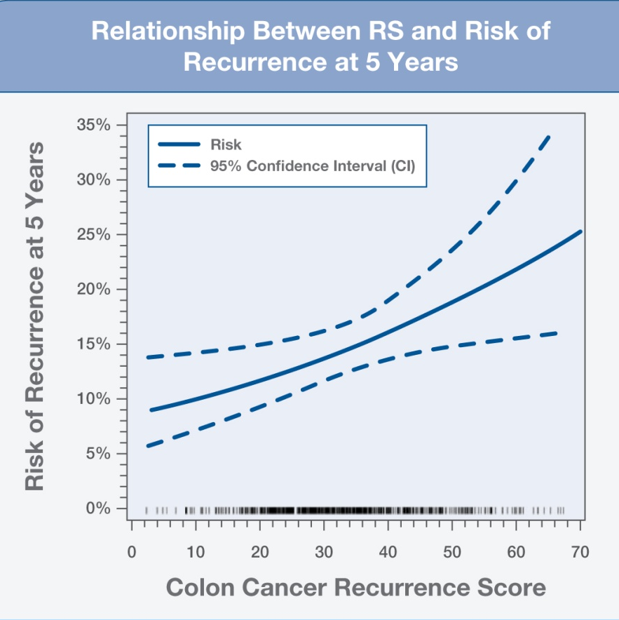
CALGB 9581 Primary Analysis: Association of Continuous RS with Recurrence Risk
Variable | HR | 95% CI | P value
RS per 25 units | 1.52 | (1.09, 2.12) | 0.013
The continuous RS was significantly associated with the risk of recurrence
Strength of association consistent with QUASAR
Venook AP, et al. J Clin Oncol. 2011;29: abstract 3518.
Notes:
Main point:
The pre-specified primary endpoint was met in this confirmatory study for the 12-gene RS: Primary analysis of the association of continuous Recurrence Score with recurrence risk was significant (p=0.013) in this study population of lower-risk resected stage II colon cancer patients
The solid curve depicts the relationship of continuous Recurrence Score to 5 year recurrence risk, demonstrating a near linear relationship with higher RS associated with higher recurrence risk. The dotted curves indicate 95% confidence intervals.
These results are very consistent with those of the QUASAR validation study
Method: In the pre-specified primary analysis, a Cox proportional hazards regression model was fitted to the clinical endpoint, time to Recurrence for the CALGB 9581-GHI study population, and a likelihood ratio test was used to determine if the Recurrence Score is significantly associated with the risk of recurrence.

Slide 39
Contribution of RS to Prediction of Recurrence Risk Beyond Clinical and Pathologic Covariates
Pre-specified multivariable Cox regression of RS and covariates on RFI
(n = 656, 95% of all patients)
Variable | HR | HR 95% CI | P value
Recurrence Score per 25 units | 1.68 | (1.18, 2.38) | 0.004
T stage (T4 vs. T3) | 0.93 | (0.44, 1.97) | 0.85
MMR status (deficient vs. proficient) | 0.70 | (0.42, 1.17) | 0.17
Number of nodes examined (<12 vs. ≥12) | 1.14 | (0.81, 1.60) | 0.46
Tumor grade (high vs. low) | 0.78 | (0.51, 1.18) | 0.24
LVI (present vs. not) | 1.39 | (0.85, 2.26) | 0.19
Venook AP, et al. J Clin Oncol. 2011;29: abstract 3518.
Notes:
The Recurrence Score was significantly associated with recurrence risk (p=0.004) after controlling for MMR status, T-stage, number of nodes examined, histologic grade and LVI in the multivariate cox regression of RS and covariates on recurrence free interval (n=656, 95% of all patients)
• Contribution of RS to prediction of recurrence risk beyond clinical and pathological characteristics was
also examined in two-variable models of RS and any of the following covariates: age, gender, race, T
stage, MMR status, grade, nodes examined, mucinous histology, tumor location or LVI. In this analysis, RS was significantly associated with recurrence risk after all individual clinical and pathological covariates were included in two-variable models

Slide 40
Contribution of RS to Prediction of Recurrence Risk Beyond MMR and T-Stage
Pre-specified multivariable Cox regression of RS, T stage, & MMR status on RFI (n = 656; 95% of all patients)
Variable | HR | HR 95% CI | P value
T4 vs. T3 in MMR-P patients | 1.14 | (0.53, 2.44) | 0.73
MMR-D vs. MMR-P in T3 patients | 0.62 | (0.39, 0.98) | 0.043
Recurrence Score per 25 units | 1.60 | (1.13, 2.27) | 0.008
Venook AP, et al. J Clin Oncol. 2011;29: abstract 3518.
Notes:
There were no events in 7 T4 MMR-D patients in our study providing insufficient data to estimate effect in these patients.
Contribution of RS to Prediction of Recurrence Risk Beyond MMR and T-Stage:
RS was significantly associated with recurrence risk (p=0.008) after MMR status, T stage and interaction of MMR and T stage were included in the model
In T3 patients, MMR-D was associated with significantly lower recurrence risk (p=0.04)
* There were no events in 7 T4, MMR-D patients in our study providing insufficient data to estimate effect in these patients.

Slide 41
CALGB 9581: Discriminating High vs. Low Risk of Recurrence in Standard Risk Stage II Colon Cancer
In the T3 MMR-proficient population
  RS identified 22% of patients with an average risk of recurrence at 5 years >20%
RS Groupª | % of patients^{b} | Average 5-Year Recurrence Risk (95% CI)
Low | 44 | 13% (10%, 16%)
Intermediate | 33 | 16% (13%, 19%)
High | 22 | 21% (16%, 26%)
ªGroups based on pre-specified percentile cutpoints (cutpoint equivalents for RS: <29, 29-39, and >39) ^{b}Weighted based on cohort sampling design
Venook AP, et al. J Clin Oncol. 2011;29: abstract 3518.
Notes:
The pre-specified cut-points in defining the RS groups were set at the 40th and 75th percentiles for the overall CALGB 9581 study population. The proportion of patients were slightly different for the T3 MMR-proficient population in this study, because patients with T4 tumors and MMR-D tumors may not have been evenly distributed across the three RS groups.
The average 5-year recurrence risk for T3 MMR-P patients was 13% in the low risk cohort, 16% in the intermediate risk and 21% in the high risk group.
Main Point: In the CALGB study, as was seen in the QUASAR study, the 12-gene RS was able to identify, in a standard risk stage II population, ~20 – 25% of patients with a higher risk of recurrence at 5 years.

Slide 42
Conclusions
Results confirm the 12-gene RS previously validated in QUASAR
  RS is significantly associated with risk of recurrence beyond known prognostic factors
  RS improves ability to discriminate higher vs. lower recurrence risk particularly in standard risk patients with T3 MMR-P tumors
Implications for clinical practice:
  For patients with T3, MMR-P tumors, a high RS reveals a more aggressive underlying biology for which adjuvant therapy may be more appropriately considered
Venook AP, et al. J Clin Oncol. 2011;29: abstract 3518.
Notes:
The CALGB 9581 study confirms the performance of the Recurrence Score and its association with risk of recurrence in stage II colon cancer. The RS discriminates higher from lower risks for standard risk stage II colon cancer patients who have T3, MMR-Proficient tumors.

Slide 43
Oncotype DX® Colon Cancer Assay
The Challenge with the Stage II Colon Cancer Patient
Oncotype DX Colon Cancer Assay
Development & Validation
Implications for Clinical Practice in
Stage II Colon Cancer

Slide 44
New Paradigm for Stage II Colon Cancer Treatment Planning
Existing system for recurrence risk assessment in stage II colon cancer is severely limited and not “fit for purpose”
Robust evidence to support paradigm based on T stage, MMR, and Recurrence Score to enable quantitative, individualized recurrence risk assessment of the stage II colon cancer patient
  T stage, MMR, and RS are the strongest independent predictors of recurrence risk
  Consistent performance of RS demonstrated across ~4,000 patients in development and prospective validation studies
Notes:
The existing system for assessing recurrence risk in stage II colon cancer has historically evolved based largely on observational studies of mixed patient cohorts (generally of stage II and III colon and rectal cancer).
The QUASAR validation study and the confirmatory CALGB 9581 study show consistent results that support a new paradigm for evaluating stage II colon cancer patients using: T stage, MMR status, and RS.

Slide 45
Integrating the Quantitative Recurrence Score® into Recurrence Risk Assessment and Treatment Planning for
Stage II Colon Cancer
Resected stage II colon cancer
T stage, MMR status
T3 and MMR-D
low risk
T3 and MMR-P
standard risk
T4 and MMR-P
high risk
Consider observation
Oncotype DX®
Colon Cancer Assay
Consider chemotherapy
MMR-D, mismatch repair deficient; MMR-P, mismatch repair proficient
Notes:
Oncotype DX is expected to have the greatest clinical utility for T3, MMR-Proficient patients, who constitute the majority of stage II colon cancer (~70% of pts).
Patients with MMR-Deficiency have low risks of recurrence, and may be considered for observation only.
Those stage II colon cancer patients with T4 tumors are at high risk of recurrence and may be considered for chemotherapy accordingly.

Slide 46
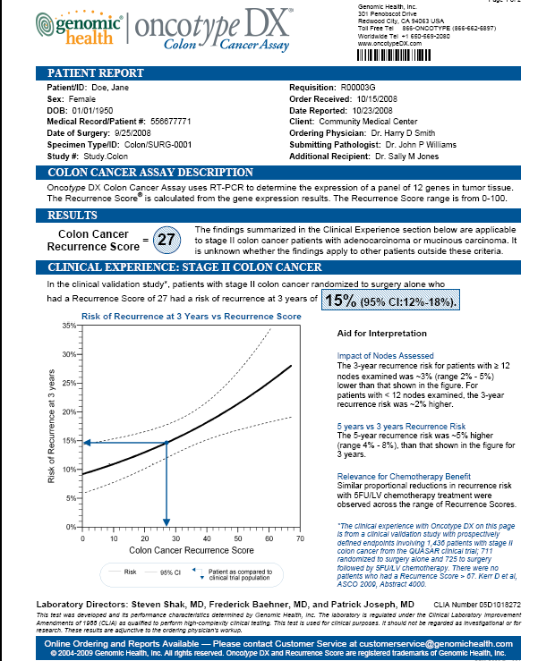
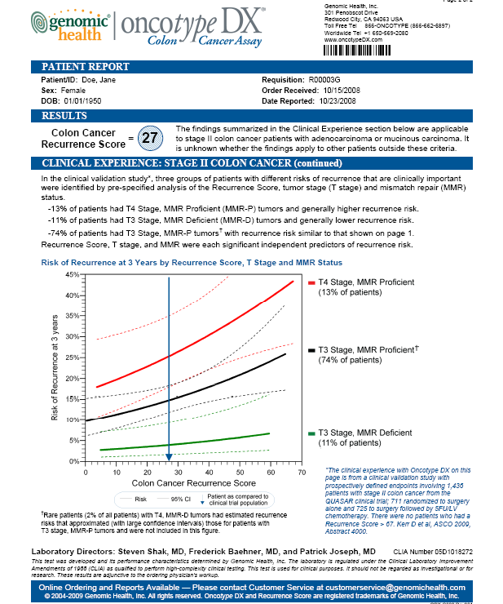
Oncotype DX® Colon Cancer Assay
Patient Report
Notes:
The result of the Oncotype DX Colon Cancer Assay is reported as depicted.
Page 1 of the report depicts the RS result both numerically and graphically, along with the individual’s 3-year risk of recurrence estimate, along with the 95% confidence intervals. The graph on page 1 displays the individual’s RS result on the RS vs 3-year risk of recurrence curve, generated from the primary analysis of the QUASAR validation study.
Page 2 of the report shows the individual’s RS result displayed on the graph depicting the relationship of RS and 3-year risk of recurrence for three groups of patients defined by T stage and MMR status: T4, MMR-Proficient patients (red curve); T3, MMR-Proficient patients (black curve); and T3, MMR-Deficient patients (green curve).”
Oncotype DX is expected to have the greatest clinical utility for T3, MMR-Proficient patients, who constitute the majority of stage II colon cancer (~70% of pts).

Slide 47
Summary
Adjuvant chemotherapy decisions for stage II patients have been based on clinical and pathologic markers that do not accurately discriminate recurrence risk particularly for the standard risk patient.
The Oncotype DX® Colon Cancer Assay quantitatively predicts individual recurrence risk and provides clinical value beyond other available measures.
The Oncotype DX Colon Cancer Assay is the foundation of Genomic Health’s efforts to improve outcomes for patients with colon cancer.
Notes:
The clinical challenge in managing stage II colon cancer is that for T3 patients, traditional parameters do not accurately predict recurrence risk. MMR status is important to assess, because MMR-Deficient patients have low risks of recurrence and may be considered for observation only.
T3, MMR-Proficient tumors represent ~70% of stage II patients, who don’t necessarily have low risk; they are at “average risk” for recurrence, ~15%. The Recurrence Score provides the most value to these patients by further identifying T3, MMR-Proficient patients at highest risk for recurrence. According to QUASAR, ~25% of T3, MMR-P patients with RS >= 41 have recurrence risk levels that are as high as those for patients with T4 disease; as such, these patients may be considered for adjuvant chemotherapy.
Genomic Health is continuing to invest in developing new genomic-based assays to meet the needs of colon cancer patients.

Slide 48
APPENDIX

Slide 49
Supporting Slides on Oncotype DX Colon Cancer Assay Development & Validation

Slide 50
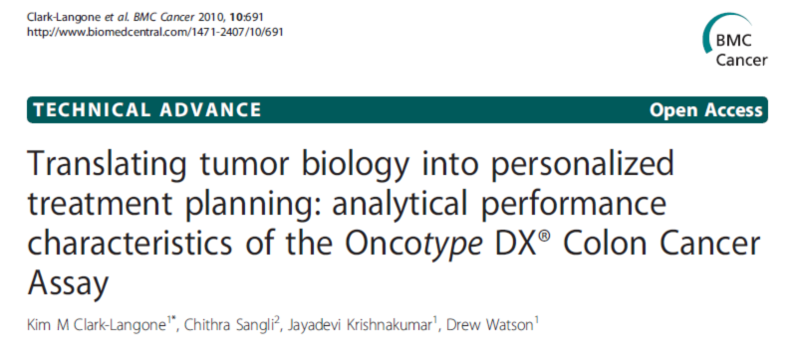
Analytical Validation of the
Oncotype DX® Colon Cancer Assay
Clark-Langone et al, BMC Cancer 2010
“The high precision of the individual genes translates into a similarly high level of precision for the stromal gene group score (SD≤0.04), the cell cycle gene group scores (SD≤0.05) and the RS (SD≤1.38).”
Notes:
Analytical performance characteristics shown for both individual genes and gene groups in the Oncotype DX® Colon Cancer Assay demonstrate consistent translation of individual tumor biology into clinically useful diagnostic information. The results of the analytical validation studies reported in this paper illustrate how the analytical capability of the Oncotype DX Colon Cancer Assay has enabled clinical validation of a test to determine individualized recurrence risk after colon cancer surgery.
The studies described in this paper demonstrate the precision and reproducibility of the standardized Oncotype DX assay process; estimates provided on the slide are for variance of the components of the RS (stromal gene group and cell cycle gene group scores) as well as the RS, for the same sample run through the process on different days, and with different equipment, operators, and reagent lots. These results give confidence that the Oncotype DX results can be reliably obtained for individual patients and thus appropriately applied in treatment planning for stage II colon cancer patients.
Clark-Langone KM, Sangli C, Krishnakumar J, et al. Translating tumor biology into personalized treatment planning: analytical performance characteristics of the Oncotype DX® Colon Cancer Assay. BMC Cancer. 2010;10:691.

Slide 51
Gene Discovery and Gene Refinement Studies:
Oncotype DX® Colon
Correlation between gene expression and recurrence-free interval (RFI) across four independent studies. Total of 1851 patients.
Treatment | Study and Site | # Patients (Stage II/III) | # Genes
Surgery Alone | C01/C02 NSABP, Pittsburgh, PA | 270 (131/139) | 761
Surgery Alone | Cleveland Clinic Cleveland, OH | 765 (504/261) | 375
Surgery plus 5FU/LV | C04 NSABP, Pittsburgh, PA | 308 (137/171) | 761
Surgery plus 5FU/LV | C06 NSABP, Pittsburgh, PA | 508 (235/273) | 375
O’Connell et al. 2010 JCO 28:3937
Notes:
Stage II and III colon cancer patients were included in the development studies (numbers as indicated in table). 761 genes were assessed in the NSABP C01/C02 as well as the NSABP C04 studies. Based on results from these first two development studies, the gene list was refined to 375 candidate genes for the remaining two studies (Cleveland Clinic (CCF) and NSABP C06).
Total stage II colon cancer cases in development studies = 1007
Total stage III colon cancer cases in development studies = 844
Details:
Data from stage II and stage III colon cancer patients were included in the development studies and used to identify and select the genes for both recurrence risk and differential 5FU/LV benefit. Selected genes and algorithms were evaluated in the subset of stage II patients from the development studies for verification.
Treatment benefit genes would be expected to have a different relationship with patient outcome in surgery alone vs surgery+5FU (i.e. gene expression by treatment interaction). However, since the surgery alone and the surgery+5FU patients came from completely independent studies, a different relationship of a gene’s expression with outcome could either be related to treatment or something else different between the studies (e.g. patient populations). Given the lack of randomized studies comparing stage II colon cancer patients treated with surgery alone vs surgery + 5FU/LV, the strategy here was to use multiple well-defined single-arm studies for each of the treatment groups, reserving the single large randomized study with available tissue (QUASAR) for validation.
References for Development Studies:
O’Connell MJ, Lavery I, Yothers G, et al. Relationship between tumor gene expression and recurrence in four independent studies of stage II/III colon cancer patients treated with surgery alone or surgery plus adjuvant 5-FU/LV. J Clin Oncol. 2010; 28:3937-3944

Slide 52
Identification of Recurrence Genes in
Development Studies
NSABP C01/C02 (surgery alone)
143 genes significant
CC (surgery alone)
119 genes significant
NSABP C04 (surgery+FU/FA)
143 genes significant
NSABP C06 (surgery+FU/FA)
169 genes significant
48 (13%) of 375 genes studied in all development studies were significantly associated with RFI (p<0.05) in both surgery alone and at least one surgery + FU/FA study
  <1 gene expected to be a false discovery
Kerr D, et al. ESMO 2010 #83PD.
Notes:
To identify genes associated with recurrence, results from the 4 independent development studies were examined for consistency. While more than 100 genes were found to be significantly associated with recurrence in any one of the individual development studies (shown as open ovals), a set of 48 genes were consistently found to be associated with recurrence in multiple studies (at least 3 of the 4 studies). By looking across these datasets, with more than 1850 patients in aggregate, recurrence genes could be identified with confidence, as evidenced by the fact that <1 of these 48 genes would be expected to be a chance finding.

Slide 53
Assessment of 761 Candidate Genes in 1,851 Patients
in the Development Studies to Yield Final
Pre-specified Assay for Validation in QUASAR
48 Recurrence and 66 Treatment Benefit Genes Significant
Across Development Studies
Modeling and Analytical Performance
FINAL ASSAY
7 Recurrence Genes
6 Treatment Benefit Genes
5 Reference Genes
RECURRENCE SCORE
(0-100)
TREATMENT SCORE
(0-100)
O’Connell et al. 2010 JCO 28:3937
Kerr et al., ASCO® 2009, #4000
Notes:
Key points:
761 candidate genes, culled from the colon cancer literature and gene expression array data (and including KRAS mutations), were studied for their relationship to recurrence in the 1,851 patients with resected colon cancer from the development studies with NSABP and Cleveland Clinic.
Genes selected for recurrence and prediction of treatment benefit were identified on the basis of their significance and consistency across studies, and were found to represent biological pathways with plausible association with colon cancer progression
Multiplicity and size of studies allowed discovery of these colon cancer genes with higher confidence (low false-discovery rate)
The final set of 7 recurrence genes, which yield a Recurrence Score scaled from 0 to 100, and a distinct set of 6 treatment benefit genes, which yield a separate Treatment Score scaled from 0 to 100, was determined based on modeling and analytical performance of the genes. Expression of this final set of genes was normalized to the average expression of the reference genes.
Details:
761 candidate genes were studied in the NSABP C01/C02 (surgery alone) and NSABP C04 (surgery+5FU/LV) development studies. Based on the results of these studies, the gene list was refined to 375 genes, which were then studied again in the Cleveland Clinic study (surgery alone) and NSABP C06 (surgery+5FU/LV).
KRAS mutation was included among the 761 genes studied in this program. KRAS mutation was not found to be either related to recurrence following surgery or related to differential treatment benefit with 5FU.
48 genes were found to have a consistent and significant association with recurrence-free interval (RFI) (p<0.05) in at least 3 of the 4 development studies. Fewer than 2 of the 48 genes are expected to be false discoveries by the Benjamini-Hochberg method. In the two surgery alone studies (NSABP C01/C02 and Cleveland Clinic), 63 genes were found to have a consistent and significant relationship with RFI. These were univariate analyses, with no adjustment for multiple comparisons.
The recurrence genes largely fell into two groups, the cell cycle and stromal gene groups, which were consistently found to be associated with recurrence in multiple development studies. Gene expression for the final selected 7 cancer recurrence genes is normalized to the average expression level of the 5 reference genes. Expression of the cell cycle group, including Ki67, is associated with better outcome in stage II colon cancer following surgery, and this result is consistent with reports in the literature, including studies by the NSABP. Cell cycle genes are well-known to produce different effects in different biological contexts, ranging from promotion of proliferation to induction of cell senescence or apoptosis. Expression of the stromal gene group is associated with poor outcome in colon cancer, which is consistent with observations in the literature that stromal genes are associated with induction of tumor cell proliferation, tumor invasion, and metastasis. GADD45B is a marker of genotoxic stress and may be indicative of tumor-stroma interactions which allow for more aggressive tumor behavior.
66 genes were found to have evidence for a gene expression by treatment interaction at a significance level of p<0.10 when the 4 studies were examined in aggregate. Expression of these genes appeared to be associated with differences in proportional benefit with adjuvant 5FU/LV. 37 of these genes are expected to be false discoveries by the Benjamini-Hochberg method. Treatment benefit genes represented multiple key biological pathways in colon cancer.
The Recurrence Score contains genes identified as consistently and significantly associated with RFI in the 1851 patients from the development studies. The genes used to calculate the Recurrence Score include the cell cycle group (Ki-67, MYBL2, C-MYC), the stromal group (FAP, INHBA, BGN) and GADD45B.
In the Development studies, recurrence genes and treatment benefit genes generally did not appear to be overlapping. As a result, the assay taken forward into the QUASAR validation study had separate gene sets and algorithms for predicting recurrence risk and differential 5FU/LV benefit.
References for Development Studies:
O’Connell MJ, Lavery I, Yothers G, et al. Relationship between tumor gene expression and recurrence in four independent studies of stage II/III colon cancer patients treated with surgery alone or surgery plus adjuvant 5-FU/LV. J Clin Oncol. 2010; 28:3937-3944

Slide 54
QUASAR: 5FU/LV Chemotherapy Benefit in the 1,436 Evaluable Stage II Colon Cancer Patients
RFI (recurrence-free interval)
DFS (disease-free survival)
OS (Overall Survival)
Kerr et al., ASCO® 2009, #4000
Notes:
Key points:
For the evaluable 1,436 stage II colon cancer patients in the validation study, the impact of 5FU/LV chemotherapy for all three clinical endpoints was generally consistent with the results observed for stage II patients in the overall QUASAR study. The benefit of chemotherapy in this study, as reported previously, was small.
Details:
Impact of adjuvant 5FU/LV chemotherapy in 1,436 stage II colon cancer patients. Kaplan-Meier analyses for surgery alone vs surgery+5FU/LV patients in the present study, according to RFI (recurrence-free interval), DFS (disease-free survival), and OS (overall survival). RFI was primary clinical endpoint for the study while DFS and OS were secondary clinical endpoints.

Slide 55
QUASAR Results: Recurrence Score® and
Alternative Endpoints
Disease
Free
Survival
Overall Survival
Kerr et al., ASCO® 2009, #4000
Notes:
Key points:
The continuous Recurrence Score was significantly associated with both DFS and OS, the secondary clinical endpoints for the study.
Consistency across all three endpoints studied (RFI, DFS, and OS) reinforces confidence in the association of the continuous Recurrence Score with outcome in stage II colon cancer following surgery.
Details:
As expected, the inclusion of survival events in the DFS and OS endpoints (death from any cause) results in attenuation of the HR for association of the Recurrence Score with these endpoints. Tumor biology would not be expected to predict death from causes OTHER than colon cancer.

Slide 56
QUASAR Results: Prediction of Differential 5FU/LV Benefit for Treatment Score
Continuous Treatment Score and Treatment Benefit with 5FU/LV
  Treatment Score by Treatment Interaction for RFI:
  interaction p = 0.19
Selected Secondary Analyses
  Treatment Score by Treatment Interaction not significant when adjusted for prognostic covariates
  Treatment Score by Treatment Interaction not significant for DFS (interaction p=0.12) or OS (interaction p=0.15)
Kerr et al., ASCO® 2009, #4000
Notes:
Key points:
A second, separate score, the Treatment Score, based on a distinct set of 6 genes, was tested for prediction of differential benefit with adjuvant 5FU/LV.
The primary and secondary analyses for Treatment Score, including a test for interaction between the continuous Treatment Score and treatment, did not meet a significance level of 0.05
Details:
The study protocol specified fixed, sequential hypothesis testing for the primary analysis, such that Recurrence Score association with recurrence following surgery was assessed first, and conditional on the significance of that hypothesis, the analysis moved on to assess for interaction between the continuous Treatment Score and treatment. The continuous Treatment Score by treatment interaction was not significant at p<0.05 level in the primary analysis, and did not meet this level of significance after controlling for prognostic covariates and when assessed for the secondary clinical endpoints DFS and OS.

Slide 57
Relationship of 5FU/LV Benefit to Recurrence Score® : QUASAR Results
Secondary Analysis in QUASAR
Examination of Recurrence Score in surgery alone and 5FU/LV-treated patients:
RS by Treatment interaction p=0.76
Risk
Prognostic,
NOT predictive
Score
Prognostic
AND predictive
Risk
Score
Prognostic
AND predictive
Risk
Surgery Alone
Surgery + Chemo
Score
Notes:
Key points:
To sort through these potential scenarios, in a pre-specified secondary analysis, the relationship of the Recurrence Score in surgery alone and surgery+5FU/LV patients was examined in QUASAR, through use of the test of interaction. The continuous Recurrence Score did not have significant interaction with treatment (i.e. surgery alone vs surgery+chemotherapy) (p=0.76); thus, the validation study results support the top scenario and exclude the bottom two scenarios (which are grayed out on the slide).
The absence of a Recurrence Score by treatment interaction reveals that the proportional benefit of adjuvant 5FU/LV is not significantly different across the range of Recurrence Score.
In the setting where PROPORTIONAL benefit with treatment is similar across a population, ABSOLUTE benefit with treatment will be expected to be lower at low baseline risk and higher at high baseline risk.
Details:
“Differential 5FU/LV benefit“ – refers to a differential proportional benefit (relative risk reduction) with 5FU/LV treatment as a function of the classifier. To illustrate this concept, suppose that we have a hypothetical patient population with an overall 20% risk of recurrence, for which therapy reduces the recurrence risk to an average of 16% (20% relative risk reduction). An example of differential treatment benefit would be where a classifier-defined group of patients experiences a 10% relative risk reduction with treatment (e.g. treatment reduces risk from 20% to 18% (2% absolute risk reduction)) while another classifier-defined group of patients experiences a 30% relative risk reduction with treatment (e.g. treatment reduces risk from 20% to 14% (6% absolute risk reduction)).
In the absence of differential treatment benefit, the expected ~20% relative risk reduction with 5FU/LV treatment in stage II colon cancer would be expected to be similar across the range of Recurrence Score, such that a patient with 10% baseline risk would be expected to have risk reduced to 8% with treatment and a patient with 25% baseline risk would have their risk fall to 20% with treatment.
In this study, examination of both treated and untreated patients gives us knowledge of the degree of treatment benefit for different groups of patients. This analysis reveals that segregation of patients by Recurrence Score does not allow identification of patients with significantly higher or lower proportional 5FU/LV benefit, with the implication that patients across the range of Recurrence Score derive similar proportional benefit from 5FU/LV.

Slide 58
Tumor Grade

Slide 59
Pathologic Markers and Recurrence Risk:
Interaction with Stage in Development Studies
Interaction of stage and covariate
p = 0.11
MMR
p = 0.07
T Stage
Grade
p = 0.005
Mucinous
p = 0.11
0
1
2
3
4
HR
Stage II
Stage III
Analysis of 634 stage II colon cancer patients (≥12 nodes examined) and 844 stage III colon cancer patients from NSABP C01/C02, C04, C06 and Cleveland Clinic studies
O’Connell et al ASCO® GI 2010 abstr 280
Notes:
In the QUASAR validation study, high tumor grade was significantly associated with LOWER risk of recurrence in stage II colon cancer following surgery. Tumor grade was assessed centrally by a single academic pathologist with expertise in colorectal cancer (G. Iezza, UCSF).
The premise that high tumor grade is associated with worse patient outcome is largely derived from older studies involving pooled stages (stage I-IV) of colon cancer. In more modern analyses, with large series of stage II colon cancer patients, the observation reported for QUASAR has been consistently observed.
This slide shows the results of a comparison of pathologic features in stage II colon cancer patients (with at least 12 nodes examined) (n=634) and stage III colon cancer patients (n=844) in a series of trials conducted by Genomic Health with the NSABP and the Cleveland Clinic (O’Connell et al ASCO GI 2010; O’Connell et al ASCO 2010). In this analysis, high tumor grade was associated with LOWER recurrence risk in stage II colon cancer but HIGHER recurrence risk in stage III colon cancer, with the statistical test for interaction (grade by stage) being highly significant. A consistent finding was also observed in the European PETACC-3 trial.

Slide 60
PETACC-3: Prognostic Value by Stage
Multivariate Analysis in whole population (n=1404)
Markers | Stage II |  | Stage III
 | HR§ | p value* | HR§ | p value*
T Stage (T4 vs T3) | 2.8 | 0.0001 | 1.6 | 0.0006
N Stage (N2 vs N1) | N/A | N/A | 2.2 | <0.0001
Histologic Grade (3-4 vs 1-2) | 0.6 | 0.55 | 1.4 | 0.07
Age (>60 vs ≤60) | 1.8 | 0.026 | 1.1 | 0.3
MSI (High vs Stable) | 0.3 | 0.027 | 0.7 | 0.12
p53 (High) | 0.7 | 0.27 | 1.3 | 0.015
SMAD4 (any loss) | 1.0 | 0.9 | 1.6 | 0.0002
Treatment, Sex, Site, KRAS, BRAF, TS, 18qLOH (Stage II: HR 1.4, p=0.33), hTERT: not significant
* p values from the Wald test in a multiivariate Cox regression
§ HR = hazard ratio
Adapted from Roth et al ASCO® 2009
Notes:
In the QUASAR validation study, high tumor grade was significantly associated with LOWER risk of recurrence in stage II colon cancer following surgery. Tumor grade was assessed centrally by a single academic pathologist with expertise in colorectal cancer (G. Iezza, UCSF).
The premise that high tumor grade is associated with worse patient outcome is largely derived from older studies involving pooled stages (stage I-IV) of colon cancer. In more modern analyses, with large series of stage II colon cancer patients, the observation reported for QUASAR has been consistently observed.
This slide shows the results of a comparison molecular and pathologic features by stage in the PETACC-3 study. Here, we observe a very similar pattern of relationship between grade and outcome in stage II disease as observed in QUASAR (Kerr et al ASCO 2009) and the NSABP and Cleveland Clinic development studies (O’Connell et al ASCO 2010).

Slide 61
Cleveland Clinic Study:
Reproducibility of Tumor Grading
Tumor Grade: Using the two-tier scheme, agreement between the two pathologists was low in all patients and moderate if mucinous tumors were excluded.
All patients with
non- mucinous tumors
All Patients
 | P1 Grade
P2 Grade | Low | High | Total
Low | 315 | 34 | 349
High | 98 | 55 | 153
Total | 413 | 89 | 502
 | P1 Grade
P2 Grade | Low | High | Total
Low | 315 | 34 | 349
High | 13 | 33 | 46
Total | 328 | 67 | 395
Kappa = 0.30, 95% CI (0.21, 0.39)
Kappa =0.52, 95% CI (0.40, 0.64)
Lavery I, et al. ASCO GI 2011 #526.
Notes:
Tumors from 504 stage II colon cancer patients treated with surgery alone at the Cleveland Clinic were analyzed by two academic GI pathologists, designated as P1 and P2 for the purpose of this study. The two pathologists used the same definition to assess grade (percent tumor with gland-like structures); the primary difference between the grading systems used by the two pathologists was that pathologist P2 used the two-tiered WHO system, with well- and moderately-differentated tumors classified as low grade and poorly differentiated as high grade. In addition, all mucinous tumors were considered high grade by P2, in accord with WHO criteria. For analysis purposes, to enable comparison of tumor grade from both pathologists, tumor grade by pathologist P1 was grouped as follows: well and moderately differentiated were grouped as low grade, and poorly differentiated as high grade.
This analysis explored the agreement of tumor grading between pathologist P1 and pathologist P2. Agreement between the two pathologists was low (kappa= 0.30) when all patients were included in the analysis. Given the difference in how the pathologists treated mucinous tumors, this concordance analysis was performed with exclusion of mucinous tumors. Even in this setting, the association between the two pathologists was moderate (kappa=0.52).
Reference:
Lavery IC, Baehner FL, Lopatin M, Iezza G, Millward C, Clark-Langone K, Lee M. Reproducibility of Colon Tumor Grade and Relationship to Recurrence in the Context of Clinical, Pathologic, and Genomic Tumor Features in 504 stage II Colon Cancer Patients Treated with Surgery Alone at the Cleveland Clinic ASCO GI 2011 Abstract#526.

Slide 62
Tumor Grade: Limited Utility for Risk Assessment in Stage II Colon Cancer
Stage-specific association with outcome
  Data for tumor grade has historically come from studies of colon cancer with pooled stages
  Larger series from Development studies, PETACC-3 demonstrate stage specificity. QUASAR with consistent finding of good prognosis with high grade in stage II
  Conventional wisdom of high grade as poor prognostic factor does not apply in stage II disease
Lack of standardization and limited inter-pathologist reproducibility of tumor grading
Confounding relationship with MMR and mucinous histology
  MMR-D tumors known to be more commonly right-sided, high grade, and have mucinous histology

Slide 63
Lymphovascular Invasion

Slide 64
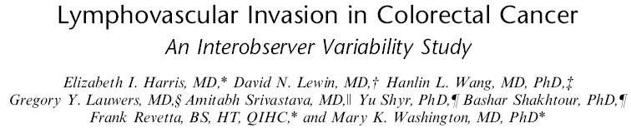
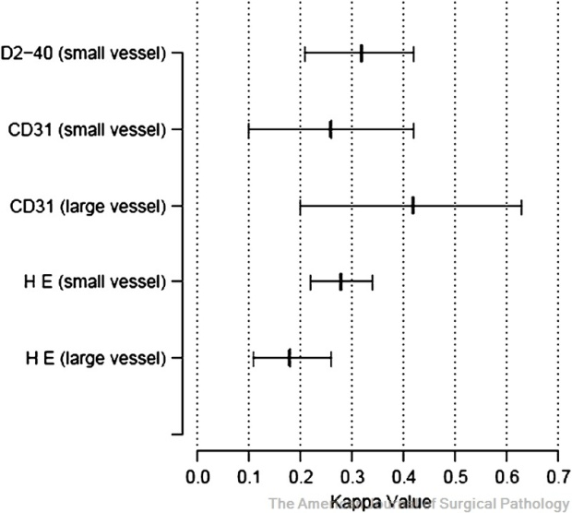
Design: 6 GI pathologists
  50 stage II, moderately differentiated CRC
  Assessment of H&E and IHC for D2-40 and CD31 (endothelial markers)
Results
  Low concordance (kappa 0.18-0.28) with H&E
  Minimal improvement with IHC (kappa 0.26-0.42)
Conclusion
  “Interobserver variability in diagnosis of LVI was substantial on H&E slides and did not improve upon use of IHC. Agreement in evaluation of large vessel invasion was only slightly higher than would be seen by chance alone. This study highlights the need for criteria in evaluation of LVI, as this assessment may impact patient prognosis and thus change the course of clinical treatment.”
Am J Surg Pathol 2008, 32:1816
Notes:
Lymphovascular invasion has been considered an adverse prognostic factor in some studies, but the data has been inconsistent, and the degree of interobserver agreement among pathologists for LVI is variable. In this study, the need for standardization in evaluation of LVI is addressed, with the finding of very low concordance even among pathologists with specialization in GI malignancies. This concordance was not significantly improved even with the aid of special IHC stains to identify vascular structures.
This result should not be surprising, given that the pathology literature has repeatedly identified the need for standardization of LVI (from Compton 2007):
“In part, disparities among existing studies on vessel invasion maybe related to inherent problems in definitive diagnosis of vessel invasion, which typically requires the identification of tumor cells (single or groups) within an endothelial-lined channel; however, histologic artifacts that mimic vessel invasion and pathologic changes that obscure it (e.g., vascular destruction by tumor) are both common. Thus, interobserver variation may be substantial. Special techniques, such as immunohistochemical stains to identify endothelium or special stains to identify the elastic tissue remains of venous walls, may or may not increase the ease or accuracy of evaluation. Because
these techniques are also labor intensive, time consuming, and expensive, they are not done routinely. Detection of vessel invasion in any given case is also affected by specimen sampling….At present, no widely accepted standards or guidelines for the pathologic evaluation of vessel invasion exist, and pathology sampling practices vary widely on both individual and institutional levels. Sampling practices are further influenced by cost containment issues, which in general
have encouraged reduced sampling of resection specimens. CAP has suggested that at least three blocks (and optimally five blocks) of tumor at its point of deepest extent be submitted for microscopic examination (3, 46).
References:
Compton CC. Optimal pathologic staging: defining stage II disease. Clin Cancer Res. 2007;13(22 Pt 2):6862s-70s.
Harris EI, Lewin DN, Wang HL, et al. Lymphovascular invasion in colorectal cancer: an interobserver variability study. Am J Surg Pathol. 2008 Dec;32(12):1816-21.
Washington MK. Colorectal carcinoma: selected issues in pathologic examination and staging and determination of prognostic factors. Arch Pathol Lab Med. 2008 Oct;132(10):1600-7.

Slide 65
Challenges with Lymphovascular Invasion (LVI) as a Marker of Risk in Stage II Colon Cancer
Inter-observer concordance of LVI assessment is poor
To improve reproducibility, CAP recommends assessing at least 3 blocks (and optimally 5 blocks) of tumor at its point of deepest extent. In practice, this is unlikely to be achieved.*
At present, the pathologic evaluation of vessel invasion is not standardized, and pathology sampling practices vary widely on both individual and institutional levels*
Negative result with LVI in QUASAR likely reflects intrinsic variability in assessment of this marker
*Compton. Clin Cancer Res. 2007;13(22 Suppl):6862s-6870s
Notes:
Compton CC. Optimal pathologic staging: defining stage II disease. Clin Cancer Res. 2007;13(22 Pt 2):6862s-70s.

Slide 66
18q Loss of Heterozygosity
(18qLOH)

Slide 67
Large Studies Assessing 18qLOH in CRC (N>250)
Author (Year) | Number of Patients | Finding
Watanabe, 2001 | 279 | HR = 2.75 (p=0.006)*
Halling, 1999 | 508 | NULL
Barratt, 2002 | 314 | NULL
Roth, 2009 | 1404 | NULL†
Ogino, 2009 | 555 | NULL
* Not significant for stage II colon cancer
Adapted from Fuchs, ASCO® 2009
Notes:
The long arm of chromosome 18 contains several genes believed to be associated with colon carcinogenesis, including DCC, SMAD4, SMAD2, and CABLES1.
Loss of heterozygosity at chromosome 18q has been suggested as a potential marker of poor outcome in colon cancer. One of the seminal publications supporting the use of 18qLOH as a prognostic marker was from a pooled stage II/III analysis (Watanabe NEJM 2001). In this analysis, 18qLOH was found to be associated with decreased survival in patients with stage III disease; 18qLOH was not found to be prognostic in patients with stage II colon cancer in that study.
This slide shows a summary of large studies of 18qLOH, as presented by Dr. Charles Fuchs from Harvard (during his discussion at the oral colorectal cancer session at ASCO 2009), demonstrating that the bulk of evidence does not support an association between 18qLOH and prognosis.
References:
Watanabe T, Wu TT, Catalano PJ, et al. Molecular predictors of survival after adjuvant chemotherapy for colon cancer. N Engl J Med. 2001;344(16):1196-206.
Halling KC, French AJ, McDonnell SK, et al. Microsatellite instability and 8p allelic imbalance in stage B2 and C colorectal cancers. J Natl Cancer Inst. 1999 Aug 4;91(15):1295-303.
Barratt PL, Seymour MT, Stenning SP, et al. DNA markers predicting benefit from adjuvant fluorouracil in patients with colon cancer: a molecular study. Lancet. 2002;360(9343):1381-91.
Roth AD, Tejpar S, Yan P, et al. Stage-specific prognostic value of molecular markers in colon cancer: Results of the translational study on the PETACC 3-EORTC 40993-SAKK 60-00 trial. J Clin Oncol 27:15s, 2009 (suppl; abstr 4002).
Ogino S, Nosho K, Irahara N, et al. Prognostic significance and molecular associations of 18q loss of heterozygosity: a cohort study of microsatellite stable colorectal cancers. J Clin Oncol. 2009;27(27):4591-8.

Slide 68
PETACC-3: Impact of MMR status on Prognostic Value of 18qLOH in stage II disease
Multivariate Analysis
Markers | HR [95% CI] | P value
T4 v. T3 | 2.34 [1.42 - 3.84] | 0.00085
18qLOH | 2.02 [1.03 - 3.96] | 0.041
T4 v. T3 | 2.58 [1.56 - 4.28] | 0.00024
MSI-H v. MSS | 0.28 [0.10 - 0.72] | 0.0089
18qLOH | 1.37 [0.67 - 2.77] | 0.38
Model without MMR/MSI
Model with MMR/MSI
Adapted from Roth et al ASCO® 2009
Notes:
In this analysis of stage II colon cancer patients from PETACC-3, a minimal multivariate model demonstrated that after adjusting for MMR status, 18qLOH was not associated with outcome. An inverse relationship between MMR status and 18qLOH has been observed, such that patients with MMR-D are rarely 18qLOH and vice-versa. In fact, in some studies, for technical reasons, 18qLOH cannot be measured in MMR-D tumors, resulting in mutual exclusivity for these two markers in those studies.
References:
Roth AD, Tejpar S, Yan P, et al. Stage-specific prognostic value of molecular markers in colon cancer: Results of the translational study on the PETACC 3-EORTC 40993-SAKK 60-00 trial. J Clin Oncol 27:15s, 2009 (suppl; abstr 4002).

Slide 69
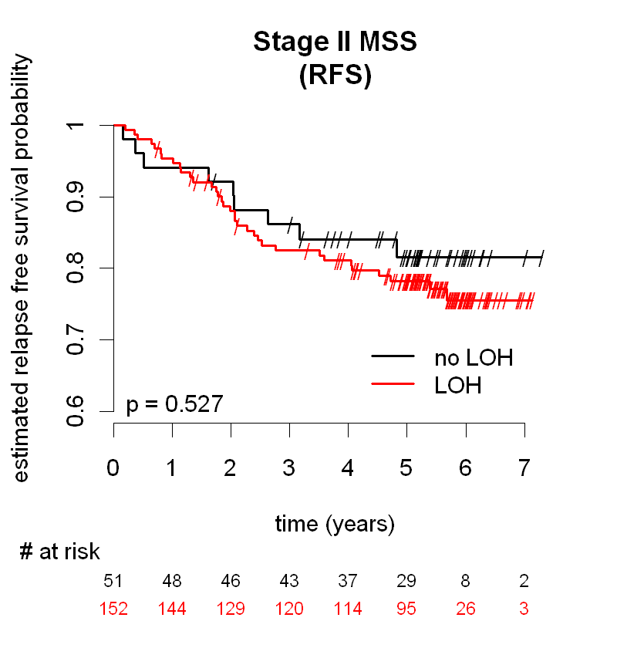
PETACC-3: Additional prognostic value of 18qLOH on MSS and MSI-H tumors in stage II disease
18qLOH not prognostic in stage II MMR-P population
18qLOH not assessable in MMR-D population due to low frequency
  18% 18qLOH (9/51)
P = 0.527
Adapted from Roth et al ASCO® 2009
Notes:
The analysis of the PETACC-3 stage II MMR-P cohort demonstrated that when examining the value of 18qLOH in a MMR-P population, 18qLOH does not show prognostic significance. Thus, this data supports the conclusion that 18qLOH is not independently prognostic in stage II colon cancer.
It was not possible to ascertain 18qLOH prognostic significance in a MMR-D cohort, due to the low frequency of 18qLOH in a MMR-D sample. An inverse relationship between MMR status and 18qLOH has been observed.
References:
Roth AD, Tejpar S, Yan P, et al. Stage-specific prognostic value of molecular markers in colon cancer: Results of the translational study on the PETACC 3-EORTC 40993-SAKK 60-00 trial. J Clin Oncol 27:15s, 2009 (suppl; abstr 4002).

Slide 70
18qLOH as a Marker of Risk in
Stage II Colon Cancer
Not supported by bulk of literature
In PETACC-3, 18qLOH not significant in multivariate model including T stage and MMR status
Prognostic value in univariate analyses may be attributable to inverse relationship with MMR status
  MMR-D tumors are rarely 18qLOH and vice versa

Slide 71

Validation of a 12-gene colon cancer Recurrence Score in stage II colon cancer patients from CALGB 9581
A.P. Venook¹, D. Niedzwiecki², M. Lopatin³, M. Lee³, P. N. Friedman⁴, W. Frankel⁵, K. Clark-Langone³, C. Yoshizawa³, C. Millward³, S. Shak³, R. M. Goldberg⁶, N. N. Mahmoud⁷, R. L. Schilsky⁸, M. M. Bertagnolli⁹
1. University of California, San Francisco, San Francisco, CA; 2. Duke University, Durham, NC; 3. Genomic Health, Redwood City, CA; 4. Cancer and Leukemia Group B, Chicago, IL; 5. The Ohio State University, Columbus, OH; 6. University of North Carolina at Chapel Hill, Chapel Hill, NC; 7. University of Pennsylvania, Philadelphia, PA; 8. The University of Chicago, Chicago, IL; 9. Brigham and Women's Hospital, Boston, MA
Venook AP, et al. ASCO 2011. Abstract 3518 (poster presentation).

Slide 72
Demographics and Clinical Characteristics
Characteristic | Value | CALGB-GHI cohort |  | Not in CALGB-GHI cohort |  | Parent trial
 |  | N=690 | %* | N=982 | %* | N=1672 | %
Age | <60 | 214 | 31.3 | 323 | 32.9 | 537 | 32.1
 | 60-70 | 231 | 33.6 | 311 | 31.6 | 542 | 32.4
 | >70 | 245 | 35.0 | 348 | 35.5 | 593 | 35.5
Gender | Male | 360 | 51.9 | 513 | 52.4 | 873 | 52.2
Race | White | 630 | 92.0 | 894 | 91.4 | 1524 | 91.5
Year of Surgery | ≤1998 | 134 | 19.5 | 140 | 14.3 | 274 | 16.4
 | 1999-2000 | 343 | 50.2 | 540 | 55.2 | 883 | 52.8
 | ≥2001 | 213 | 30.3 | 302 | 30.5 | 515 | 30.8
Treatment Arm | Observation | 343 | 50.4 | 499 | 50.4 | 842 | 50.4
 | Mab 17-1A | 347 | 49.6 | 483 | 49.6 | 830 | 49.6
* Unweighted
* Weighted based on cohort sampling design
Venook AP, et al. ASCO 2011. Abstract 3518 (poster presentation).
Notes:
The cohort of patients analyzed in the CALGB-GHI cohort was similar in demographics and clinical characteristics to the remainder of the CALGB trial patients not studied, and to the patients in the overall parent CALGB trial.

Slide 73
Demographics and Clinical Characteristics,
continued
Characteristic | Value | CALGB-GHI cohort |  | Not in CALGB-GHI cohort |  | Parent trial
 |  | N=690 | %* | N=982 | %* | N=1672 | %
T stage | T4 | 41 | 5.9 | 35 | 3.7 | 76 | 4.6
Nodes examined | <12 examined | 327 | 47.1 | 427 | 44.2 | 754 | 45.1
Lymphovascular Invasion (LVI) | Present | 78 | 10.9 | 112 | 11.5 | 190 | 11.4
Tumor Location | Right | 360 | 52.8 | 492 | 50.1 | 852 | 51.0
MMR | Deficient | 137 | 21.5 | 48 | 22.9 | 185 | 21.4
Obstruction or Perforation | Present | 11 | 1.7 | 19 | 2.1 | 30 | 1.8
Central Mucinous Histology | Present | 124 | 18.4 | ** | ** | ** | **
Central Tumor grade | High | 220 | 32.4 | ** | ** | ** | **
* Weighted based on cohort sampling design
** No comparable variable in parent trial
Venook AP, et al. ASCO 2011. Abstract 3518 (poster presentation).

Slide 74
RFI and Clinical and Pathologic Covariates: Univariable Analysis
Variable | Value | HR | HR 95% CI | P value
MMR (deficient vs intact) | 21% MMR-D | 0.62 | (0.39,0.99) | 0.044
T Stage (T4 vs T3) | 6% T4 | 1.19 | (0.60,2.37) | 0.616
Number of Nodes Examined (<12 vs ≥12) | 47% <12 nodes | 1.17 | (0.85,1.62) | 0.342
Number of Nodes Examined | continuous per 1 node | 0.98 | (0.96,1.00) | 0.062
Tumor Grade (high vs low) | 32% high grade | 0.74 | (0.52,1.07) | 0.114
Lymphovascular Invasion (present vs not) | 11% LVI present | 1.56 | (0.98,2.50) | 0.062
Mucinous Histology | 18% mucinous | 0.73 | (0.46,1.16) | 0.179
Tumor Location (right-sided vs other) | 53% right-sided | 0.79 | (0.57,1.10) | 0.158
Age (≥ 70 years vs <70 years) | 35% ≥ 70 years | 1.21 | (0.87,1.69) | 0.259
Age | continuous per 1 year | 1.01 | (1.00,1.03) | 0.145
Gender (male vs female) | 52% male | 1.14 | (0.82,1.58) | 0.422
Venook AP, et al. ASCO 2011. Abstract 3518 (poster presentation).

Slide 75
Summary
Continuous RS was significantly associated with risk of recurrence in a large set of well-defined stage II colon cancer patients
Continuous RS predicted risk of recurrence beyond other covariates such as T stage, MMR, number of nodes examined, grade and LVI
MMR-D was associated with lower risk of recurrence, consistent with prior studies
Among T3 MMR-Proficient patients, RS identified 22% of patients with average 5-year risk of recurrence > 20%. This improves the ability to discriminate higher from lower recurrence risk stage II colon cancer patients beyond known prognostic factors
Venook AP, et al. ASCO 2011. Abstract 3518 (poster presentation).

